Slide 1
Eagle Project Proposal
Kye Viall

Slide 2
Overview
To enlighten the walking trail around the pond at Lewisboro Town Park
This project will go hand in hand with the ADA Accessible Nature Trail to be installed in the spring
I have planned 3 elements to make up this project

Slide 3
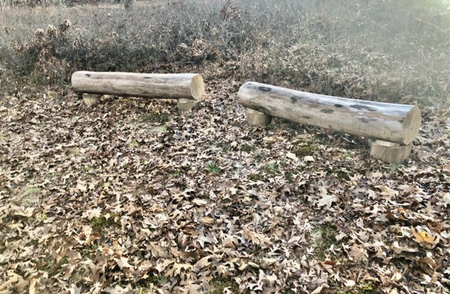
Log Benches
3-5 benches
They are for an outdoor classroom
Can be utilized by town camp’s nature program
Could just be a fun place for children to hang out!

Slide 4
Log bench design
They will look like this one in Mt. Holly Preserve
Wedges will keep it from rolling away
The stumps will keep it off the ground so it will take much longer to decompose.

Slide 5
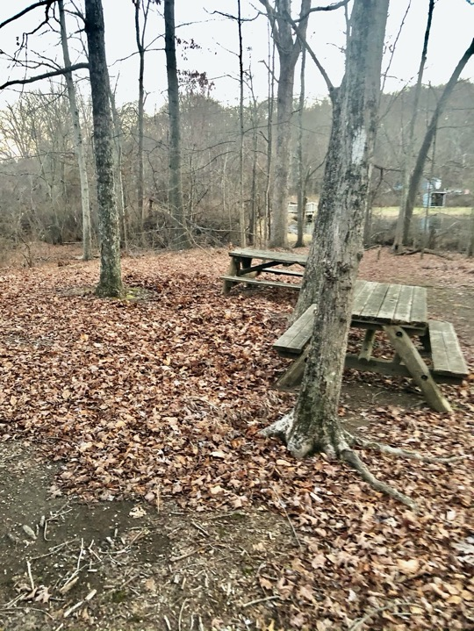

Slide 6
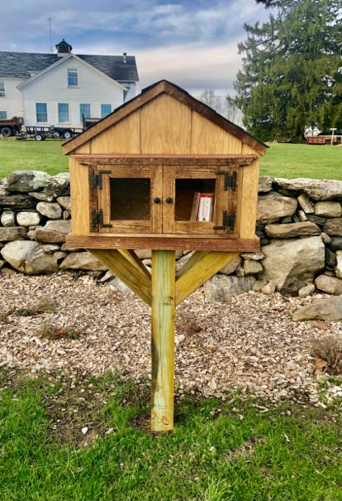
Lending Library
Will be very similar to this one at Onatru
Will contain shorter books to take on a nice stroll around the pond, both for children and adults
It also will contain field guides for people looking to observe local wildlife
About 56 in. tall and 30 in. wide

Slide 7
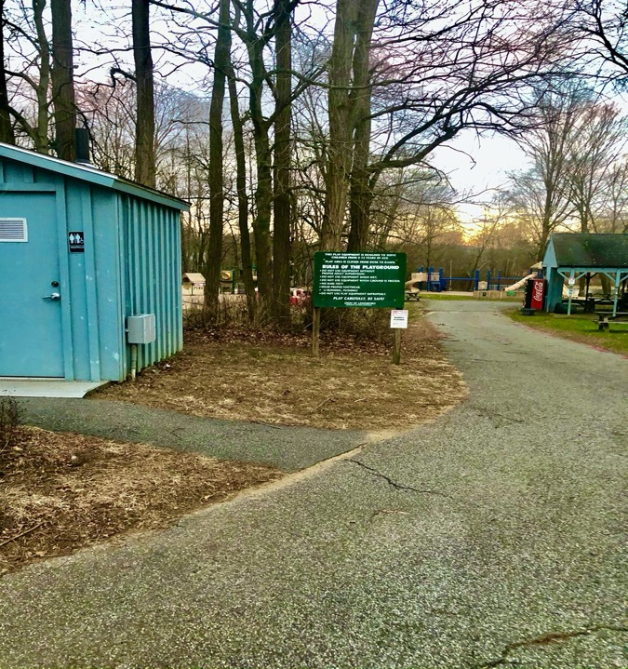

Slide 8
Nature Signs
First Sign
At the head of the trail near swing set
Will contain information on things to look for
Bird calls
Animal Tracks
Burrows/nests
Second Sign
By the first shack
Will contain information about the environment
Food Chain
Examples of native animals/plants
An overview of the habitat

Slide 9
Locations

Slide 11
Benefits
Enhance the visitor’s experience at Lewisboro Town Park
Provide more activities for kids and adults by encouraging them to interact with the outdoors
Will enhance the town camp program and open the door for possible nature programs in the town park

Slide 12
Why have I chosen this as my Eagle Project?
I have lived 1 mile from the Lewisboro Town Park my entire life. I have made countless memories to cherish there, from Town Camp to cross country. In choosing this as my Eagle Project, I feel that this is my chance to give back to this place that has given so much to me.

Slide 13
Thank You for listening!

