Slide 1
Lewisboro Library budget presentation
2/14/2022
2/14/22

Slide 2
Lewisboro Library Funding from the Town of Lewisboro
The Lewisboro Library is an association library. It is a 501©3 nonprofit organization that is chartered by the NYS Education Department as a public library.
The Library annually negotiates and contracts with the Town to deliver library services.
The Town currently funds the library at $455,914 or 69.6% of the Library’s operating budget.
This is only 3.3% of the Town’s total budget of $13,747,170. (This is down from 3.6% in 2021.)
In 2020, this resulted in the Town funding the Library at $35.30 per capita. This was the lowest per capita rate for library funding in Westchester County ranking 38 out of 38 libraries. (See the following chart.)
The Library must raise the remaining 30.5% of our operating budget in order to maintain our current level of services to our community.

Slide 3
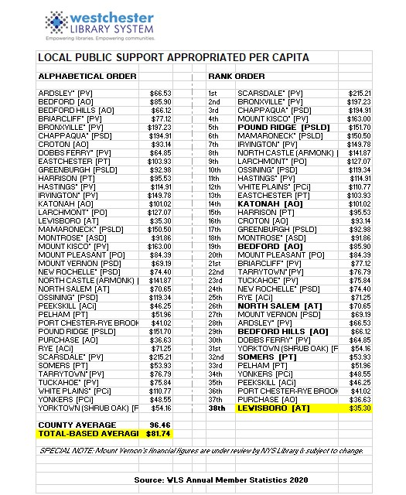

Slide 4
How do We raise the remaining funds?
Direct mail & social media annual appeals for donations
Library Fair
Library trustee directed fundraising events & sales
Library fees and fines
New York State Local Aid to Libraries

Slide 6
Library Operating Budget – Net Loss
The Library board of trustees creates the budget with the assumption that the Library will be able to raise enough money to cover the net loss.
This is done knowing that the majority of the Library’s fundraising comes in during the 4th Quarter of the fiscal year due to the timing of the Fair and the annual Holiday direct mail appeal.
What happens if the Library does not close the gap and eliminate the net loss in the budget?
We maintain an operating reserve to cover minor net losses.
Failing this, the Library would have to decrease its operating hours, services, programs and purchasing of library materials for library collection.
Since 2009, the Library has had to dip into the operating reserve 8 times to cover an annual operating fund net loss. The other 4 years were even.
In 2021, the Library finished with a net profit for the first time due to receiving a PPP forgivable loan from the federal government and some generous donations.

Slide 7
Stresses on the budget
NYS raised the minimum wage to $15.00 per hour over a period of five years. We were forced to raise the hourly wages for our part-time hourly clerks to keep up with this yearly increase. (Our clerks are paid slightly more than minimum wage.) The result was a higher than normal increase in the salary expense line as compared to other previous years.
Some expenses increased due to suppliers passing their increased minimum wages onto the fees that we were charged. (e.g custodial services, payroll service, etc.)
COVID related expenses such as PPE, increased cleaning & sanitation service & supplies, & glass & plexiglass barriers at public service desks.
IT expenses: replacing aging WIFI equipment & the staff & public computers.

Slide 8
Cost saving measures
Just a few examples of cost saving measures:
Lewisboro Library is part of the WLS cooperative which allows us to borrow materials for our patrons from any other library through the WLS delivery system.
Hours were reduced starting in 2020 eliminating our Sunday hours and Tuesday evening hours.
Library Materials budget was only increased a very small percentage to help offset personnel costs.
Negotiated with cleaning service for better rate
Created our own backroom network to avoid increased charges from WLS IT to provide for us. (We still rely on their network & equipment for WIFI, and circulation desk & reference functions. )
Removed one public computer to reduce WLS IT charge.
Leased printer/copiers instead of buying to reduce costs.

Slide 9
Salaries as percentage of budget
Salaries & Benefits | $474,279 | 72.40%
All Other Expenses | $180,816 | 27.60%
Total | $655,095 | 100.00%

Slide 10
Percentage of salaries directly serving the public
Public Service | $300,577 | 63.38%
Administrative | $173,702 | 36.62%
Total Salaries & Benefits | $474,279 | 100.00%

Slide 11
Personnel Expense as % of Total Operating Expense
In 2019, the Lewisboro Library ranked 21st in personnel expense as a percentage of the total operating expense among the 38 libraries in the Westchester Library System. This shows this is a typical percentage for public libraries. (source: WLS Annual Statistics for Member Libraries, 2019)
Our percentage was 71.5%.
2020 data was not suitable for comparison due to the pandemic shutdown. 2021 data has not yet been compiled by NYS.

Slide 12
Public service staff duties
Circulation Desk: Checking in & out library materials, issuing library cards, clearing fines & fees, answering questions.
Reference: Helping patrons find information & library materials, placing holds, gathering materials to fill holds to go to WLS libraries, helping patrons use public computers.
Collection development: Selecting library materials for all age groups to add to library collection.
Programming: Planning, creating & delivering library programs both in-person & virtually for all ages.
Youth Services: Providing programming for children & teens including story hours, early literacy, summer reading programs, book clubs, STEAM, cultural enrichment & community service.
Community Outreach: Planning & providing programming with our community partners; delivery service to homebound seniors.
Technology Literacy: Providing programming & training to help patrons better understand & utilize technology.

Slide 13
Administrative functions
Fundraising
Marketing & social media
Supervisory & scheduling
Technology maintenance both software & hardware
Processing of new library materials
Facilities management
Grant applications
Bookkeeping
Filing of regulatory reports to New York State
Website maintenance
Graphic Design
Human resources

Slide 14
Budget: other expenses
Budget – Expenses other than for Salaries & Benefits:
$180,816 - 27.6% of Total Budget
Expenses for directly serving the public: $51,000 – 28%
Library materials spending for print & digital content, DVDs, and periodicals: $42,000
Digital content purchasing with the WLS member library cooperative: $4,000
Programming: $5,000
Administrative Expenses: $129,816 - 71.8%
Payroll & retirement administration
IT expenses including WLS cooperative fee for maintaining online database & circulation system software & for providing & maintaining network hardware, staff & public computers.
Building: custodial, maintenance, utilities, insurance
Fundraising: credit card processing, printing & mailing
Marketing: Constant Contact email & digital sign subscriptions, social media coordination
Supervision & scheduling of staff
Accounting & legal fees
Training & professional development

Slide 15
Budget: public service vs administrative
Public Service & Library Materials | $351,577 | 53.67%
Administrative | $303,518 | 46.33%
Total Budget | $655,095 | 100.00%

Slide 16
Other ways we serve our community
Functioning as a warming/cooling & charging station for the community during emergencies
Providing meeting space for community & nonprofit groups
Providing cultural events such as concerts and plays
Local history center including library archives dating to c. 1800
Providing study space for students of all ages from elementary to graduate Extending library hours during high school exam periods
Providing meeting space for tutors & students
Providing quiet working space for residents with small businesses
Providing public WIFI, public computers & printers
Assisting less technologically literate patrons with using computers for job applications, government forms, etc.
Museum passes
Homebound delivery service
Proctoring exams for independent learners
Book clubs

Slide 17
Library partners in the community
The library partners with the following community partners in planning & providing programs & meeting space:
Lewisboro Land Trust
Lewisboro Garden Club
League of Women Voters
Girl Scout & Boy Scout Troops
Katonah Lewisboro schools & PTOs
Local nursery schools
Home schooling community
Town of Lewisboro: Parks & Rec Seniors program, town historian, sustainability committee & town board.

Slide 18
Thank you!
The Lewisboro Library is very grateful to all our donors and volunteers to help the Library to serve our community!
Thank you to everyone who wrote a letter to the newspaper or to the town board in support of the Library.

