Slide 1

Lewisboro Library budget presentation
2/14/2022
10/11/22

Slide 2

ways we serve our community
Functioning as a warming/cooling & charging station for the community during emergencies
Providing meeting space for community & nonprofit groups
Providing cultural events such as concerts and plays
Local history center including library archives dating to c. 1800
Providing study space for students of all ages from elementary to graduate; Extending library hours during high school exam periods
Providing meeting space for tutors & students
Providing quiet working space for residents with small businesses
Providing public WIFI, public computers & printers in the building. Wifi extends outside the building when we are open and closed.
Promoting technological literacy with workshops on Excel, Google Drive, Online privacy, etc.
Assisting less technologically literate patrons with using computers for job applications, government forms, etc.
Lending wifi hotspots for to patrons whose internet access is limited
Museum passes
Homebound delivery service
Proctoring exams for independent learners
Book clubs

Slide 3
Facts & figures
Total Circulation of Library Print & Digital Materials:
  2019 103,092
  2020 77,881
  2021 77,739
  2022* 62,885
  * As of August 2022, up 20% over August YTD 2021.
  Library Visits
  2019 63,971
  2020 36,135
  2021 46,615
  2022* 41,228
  * As of September 2022, up 19.23% over September 2022.

Slide 4
Facts & figures
Library Cards:
As of 2021, we had 5,800 library card holders.
354 new library cards added as of September 2022. 50% increased added over all of 2021.
Programs (In person & Virtual) (adults & children)
2021 programs 3,286
2022* programs 2,030
* As of September 2022 61% compared to 2021 so far.

Slide 5
Lewisboro Library Funding from the Town of Lewisboro
The Lewisboro Library is an association library. It is a 501©3 nonprofit organization that is chartered by the NYS Education Department as a public library.
The Library annually negotiates and contracts with the Town to deliver library services.
The Town currently funds the library at $455,914 or 69.6% of the Library’s operating budget.
This is only 3.3% of the Town’s total budget appropriations of $13,747,170. (This is down from 3.6% in 2021.)
Our town finance director has stated it is more correct to point out that our portion of the total tax bill is 6.2%.
In 2020, this resulted in the Town funding the Library at $35.30 per capita. This was the lowest per capita rate for library funding in Westchester County ranking 38 out of 38 libraries. (See the following chart.)
The Library must raise the remaining 30.5% of our operating budget in order to maintain our current level of services to our community.

Slide 6
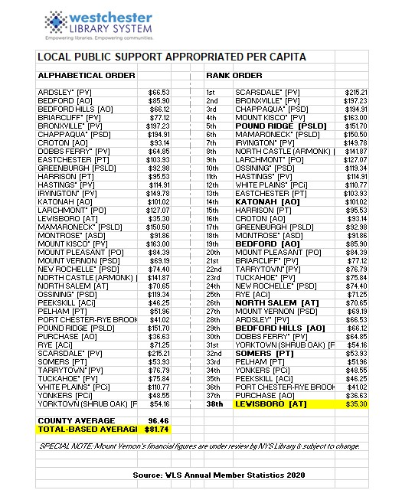

Slide 7
How do We raise the remaining funds?
Direct mail & social media annual appeals for donations
Library Fair
Library trustee directed fundraising events & sales
Library fees and fines
New York State Local Aid to Libraries

Slide 9
Library Operating Budget
– Net Loss
The Library board of trustees creates the budget with the assumption that the Library will be able to raise enough money to cover the net loss.
This is done knowing that the majority of the Library’s fundraising comes in during the 4th Quarter of the fiscal year due to the timing of the Fair and the annual Holiday direct mail appeal.
What happens if the Library does not close the gap and eliminate the net loss in the budget?
  We maintain an operating reserve to cover minor net losses.
  Failing this, the Library would have to decrease its operating hours, services, programs and purchasing of library materials for library collection.
Since 2009, the Library has had to dip into the operating reserve 8 times to cover an annual operating fund net loss. The other 4 years were even.
In 2021, the Library finished with a net profit for the first time due to receiving a PPP forgivable loan from the federal government and some generous donations.

Slide 10
Stresses on the 2023 budget
Increased pension administration costs: the library was forced to switch to a new pension company Vanguard because the old one Brighthouse was no longer offering its annuity services in New York State. We must administer two plans until retired employees can be moved off the old plan.
Expenses increasing due to suppliers passing their increased minimum wages and inflationary pressures onto the fees and prices that we are charged. (e.g custodial services, payroll service, books & media, etc.)
Audit needed: The Library usually schedules an audit every five years which we anticipate will cost in excess of $5,000.
Increased costs for utilities such as oil and electricity.
Increased custodial & maintenance costs as the building is no longer new.

Slide 11
Cost saving measures
Just a few examples of cost saving measures:
  Lewisboro Library is part of the WLS cooperative which allows us to borrow materials for our patrons from any other library through the WLS delivery system.
  Hours were reduced starting in 2020 eliminating our Sunday hours and Tuesday evening hours.
  Created our own backroom network to avoid increased charges from WLS IT to provide for us. (We still rely on their network & equipment for WIFI, and circulation desk & reference functions. )
  Removed one public computer to reduce WLS IT charge.
  Leased printer/copiers instead of buying to reduce costs.
  Dedicated trustees maintain the garden and grounds themselves instead of hiring landscaping service. (The Town provides grass cutting.)

Slide 12
Library partners in the community
The library partners with the following community partners in planning & providing programs & meeting space:
  Lewisboro Land Trust
  Lewisboro Garden Club
  League of Women Voters
  Girl Scout & Boy Scout Troops
  Katonah Lewisboro schools & PTOs
  Local nursery schools
  Home schooling community
  Town of Lewisboro: Parks & Rec Seniors program, town historian, sustainability committee & town board.

Slide 13
Thank you!
The Lewisboro Library is very grateful to all our donors and volunteers to help the Library to serve our community!
Thank you to all the many members of the community who have expressed support for the Library.

