Slide 1
2023 NYSEG Electricity Supply Contract Planning
March 27, 2023

Slide 2
TOPICS
Quick Program Overview
Market context
Schedule considerations
Adding to/enhancing our procurement options

Slide 3
WESTCHESTER POWER COMMUNITY ENERGY
COLLECTIVE POWER - the community-selected default electricity supply option for 29 participating municipalities
[Con Ed and NYSEG remain responsible for distribution - the infrastructure and billing]
100% RENEWABLE ENERGY easily accessible, vetted, at scale; default for Lewisboro
Standard supply also available
OPT-OUT FORMAT eligible customers are enrolled in the default supply unless they take action to opt out or change supply
CONSUMER-FRIENDLY structure allows you to participate with no contracts, fees, or penalties for coming or going.
RATE STABILITY stable and predictable pricing vs the monthly variability of the utility supply
Savings are not guaranteed through this program, as we cannot predict what the utility will charge month-to-month
Necessary clean energy cornerstone for our economic transition as we work to electrify our buildings and transportation, and achieve our environmental justice goals

Slide 4
NYSEG AREA CONTRACT DETAILS
Supplier: Constellation New Energy
100% Renewable Option: 10.179¢/kWh
Standard Supply Option: 8.736¢/kWh
Term Length: March 1, 2022 – November 30, 2023

Slide 5
Context: The market

Slide 6
Market: Volatile!
NYSEG Contracted

Slide 7
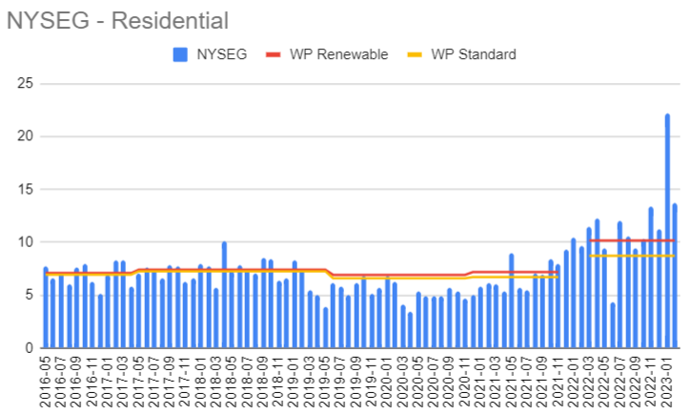
WP Fixed Rates Historical
Vs New Volatility

Slide 8
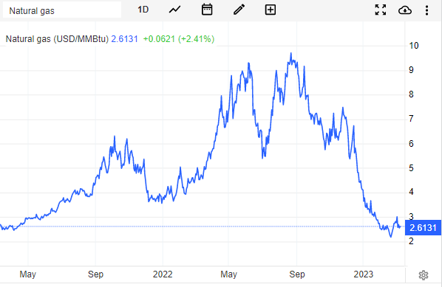
And yet at the same time, a precipitous drop
Rapid production increases
Storage up
Warm weather
European demand less than expected

Slide 9
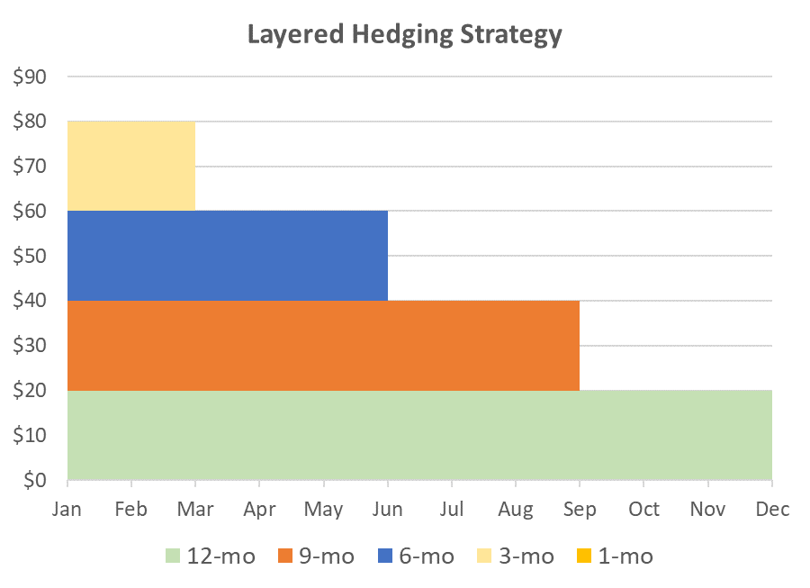
POSSIBLE response: stay closer to the market with shorter hedges
Avoid long stretches where WP base pricing is higher than the utility
An illustrative example
A% for 12-month term (green bar)
B% for 9-month term (red bar)
C% for 6-month term (blue bar)
D% for 3-month term (peach bar)
E% may remain open to real-time market

Slide 10
CONTRACTING schedule
Accelerate schedule to maximize options and buying oppty; being proactive!
Historically compliance-driven timeline
Dec 1: new contract enrollments start
Oct-Nov: opt out period
Sep: bid award
Aug: RFP period
Jul: MOU finalization
May-Jun: outreach, board meetings
Accelerated timeline
Dec 1: new contract enrollments start
Oct-Nov: opt out period
Late May: bid award
Mid May: RFP period
Early May: MOU or equivalent
Mar-Apr: outreach, board meetings
There’s a dip in the market - could be a good time to bid
Starting early is insurance against incurring a “pause” as we did with the last contract renewal
Allowing time to develop procurement diversification options

Slide 11
Procurement diversification - resources and challenges
Access to rich experience: Calpine - providing services to California CCAs for over a decade
WP has adopted their customer management platform (we’ll be able to take in utility data directly!)
Joule (CCA Admin elsewhere in NY and beyond) is also following this route and we should get feedback
Challenges
Implementation plan update
Contract must provide for follow-on energy block bidding without requiring all muni approval each time
Communications - more complex
still have a “stability” element, but there is a periodic adjustment

Slide 12
ANOTHER CHALLENGE - RECS
Tier 2 Voluntary RECs have been becoming hard to secure and the price has been driven up
NYSERDA is considering making Tier 1 RECs available to the voluntary market. This would open up supply options, but there will still be upward pressure on pricing
See previous re bundled (power plus environmental attributes) purchases through long-term contracts that would solve this

Slide 13
Context: January 19 CCA Modification Order
Provides useful clarity, but also challenges:
Any non-renewable (<50%) offering must be priced at less than the trailing 12 mo. Utility avg. plus 5%
This means in some instances (e.g. rising market) we may not be able to offer a non-renewable product, though we could offer a 50% “light green” one
DPS is to issue guidelines document by April 19, and as yet unknown:
Standards and check-ins for solicitations
Changes to Outreach & Education requirements - may affect timeline
Potentially other unforeseen regulatory obstacles

Slide 14
Path forward
Trying to keep options open as long as possible
Accelerating schedule activity to allow for earlier contracting option
That also gives time for a) change of course on our side, or b) DPS and other unknowns
Pursuing both traditional fixed price and “variable” options up until final decision point
Challenge to compare between them
Lure of the “known” vs positioning for this new volatile market, and future evolution
Standard product uncertainty issue

Slide 15
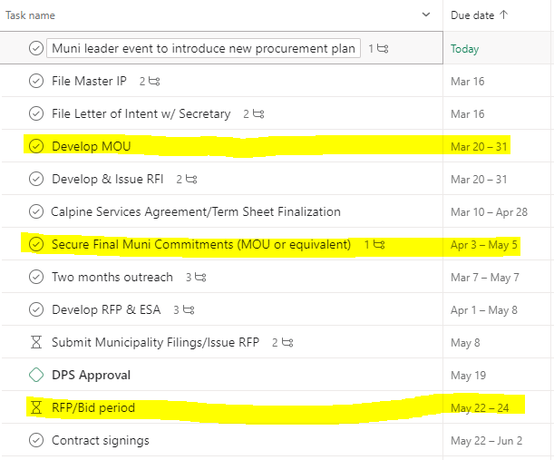
Detailed Timeline Snapshot

Slide 16
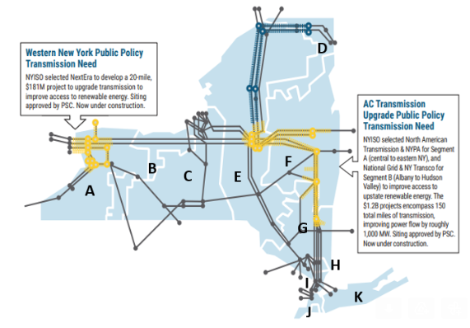
Change of Law Call: Public Policy Transmission Pass-through
PPT $/MWh by Year by Zone
NYISO Zone | 2022 | 2023
A | $0.7003 | $1.2223
B | $0.1420 | $0.3255
C | $0.1776 | $0.3757
D | $0.1212 | $0.1990
E | $0.1407 | $0.3180
F | $0.4329 | $0.8863
G | $0.4584 | $1.1070
H | $1.2092 | $2.8359
I | $1.3767 | $3.3059
J | $0.9732 | $2.3367
K | $0.2012 | $0.4787
Adjustment of ~0.11¢/kWh over the remaining contract period - ~7 months, starting in May
Letter will go out to all customers

Slide 17
Your action can help your community
build a clean energy future!
Questions?
Sustainable Westchester General
info@sustainablewestchester.org
Westchester Power
westchesterpower@sustainablewestchester.org
Check for periodic updates and more information @
sustainablewestchester.org/wp/nyseg
Call us at 914-242-4725

