Slide 1
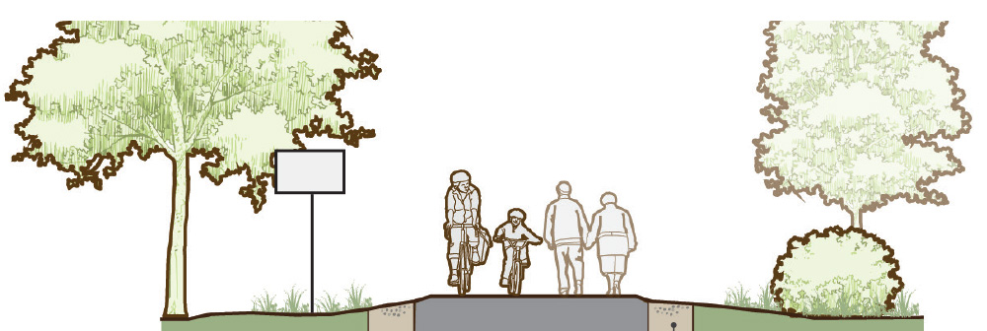
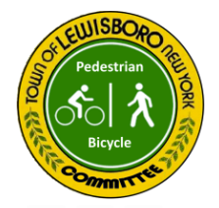
Vista - Cross River - Goldens Bridge

Slide 2
Lewisboro Ped/Bike History
2008 | Grant application for Cross River - comprehensive bike path connections from
2010 | Application for Federal Transportation, Community, and System Preservation (TCSP) grant for Goldens Bridge
2011 | Lewisboro establishes first Complete Streets policy in Westchester County
2011-12 | TCSP Grant for GB submitted again (now goes through NYSDOT
2011 | Complete Streets study of the JJ Middle School - recommended connections to Michelle Estates, connections to and aesthetic measures for the CR shopping center, access to Momsen preserve
2014 | Goldens Bridge Complete Streets study : contains many of the elements still sought today
2014-15 | Collaborative investigations of GB Rail Trail with Somers committee members; discussions with County re Lake Rd ownership,

Slide 3
Lewisboro Ped/Bike History cont’d
2014 | Master Plan Bike-Pedestrian Addendum passed (9/8/2014): key principle - removing obstacles to bike/pedestrian ; public hearing, 3 hamlet meetings; Lewisboro Ledger poll, survey,Planning Board review/hearing
2015-16 | Worked with GBHO (in formation) to organize DOT visit to GB - Jan 6, 2016
2015-03 | Request to DOT for Anderson Rd cut-through
2015-06 | GB Hamlet Development meeting; inputs were heavy on bike/ped safety
2016 | Request to DOT for upgrades to Cross River intersection; supplied CS Study and Bike/Ped MP Addendum
2016 | Old Goldens Bridge traffic calming discussions
2016 | Application for NYS TAP grant for Goldens Bridge: trying again!

Slide 4
Lewisboro Ped/Bike History cont’d
2018 | Pedestrian and Bicycle Advisory Committee formed
2019 | Bike - Ped Committee priorities include Vista Glen Dr to Oakridge Path
2020 | DOT invited and visits 3 hamlet centers to discuss pedestrian/bike safety project proposals, and additional dialog via email, phone

Slide 5
Identified projects/issues - Goldens Bridge
Key focus - North St/138 intersection: no provision for pedestrians, bike/ped path connections to Old GB, Colony, Fairmont/Green Hill

Slide 6
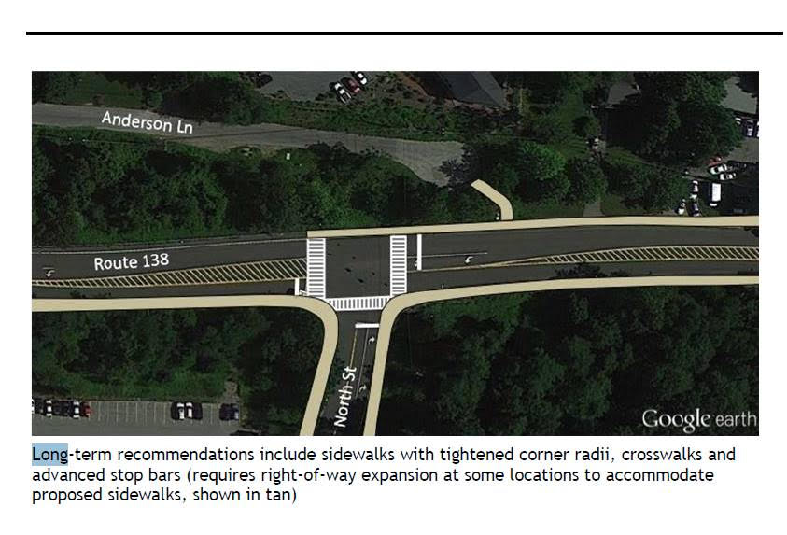
Identified projects/issues - Goldens Bridge
Key focus - North St/138 intersection: no provision for pedestrians, bike/ped path connections to Old GB, Colony, Fairmont/Green Hill

Slide 7
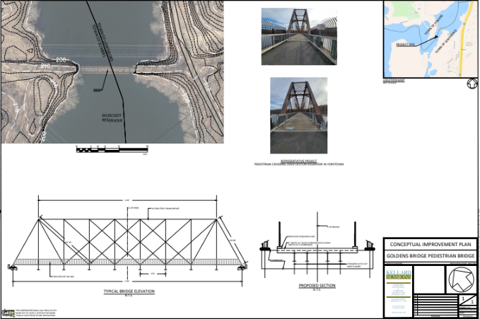
Identified projects/issues - Goldens Bridge
The bridge!

Slide 8
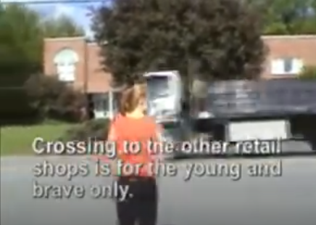
Identified projects/issues - Cross River
Crosswalks, pushbuttons, stoplight upgrades needed in all directions

Slide 9
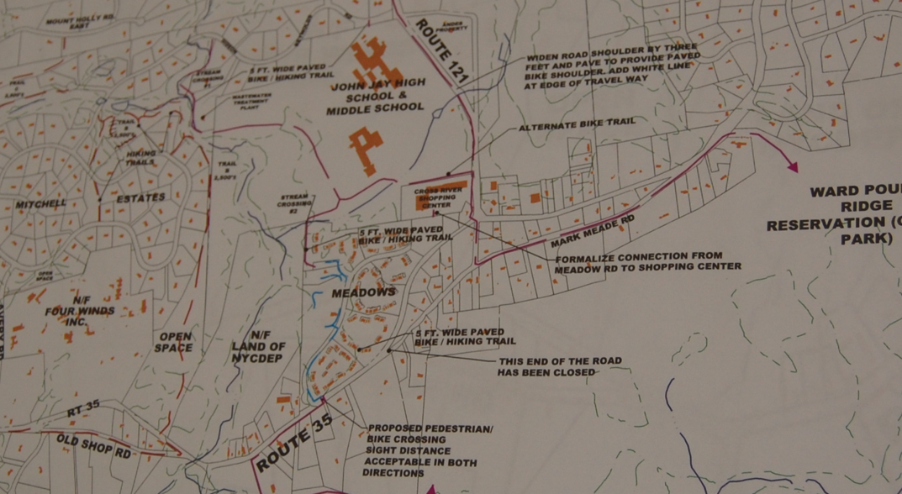
Identified projects/issues - Cross River
Connectivity hampered in all directions
Previous grant applications called for pedestrian/bike towards the Town Park, Schoolhouse Rd and access to P.R. Reservation

Slide 10
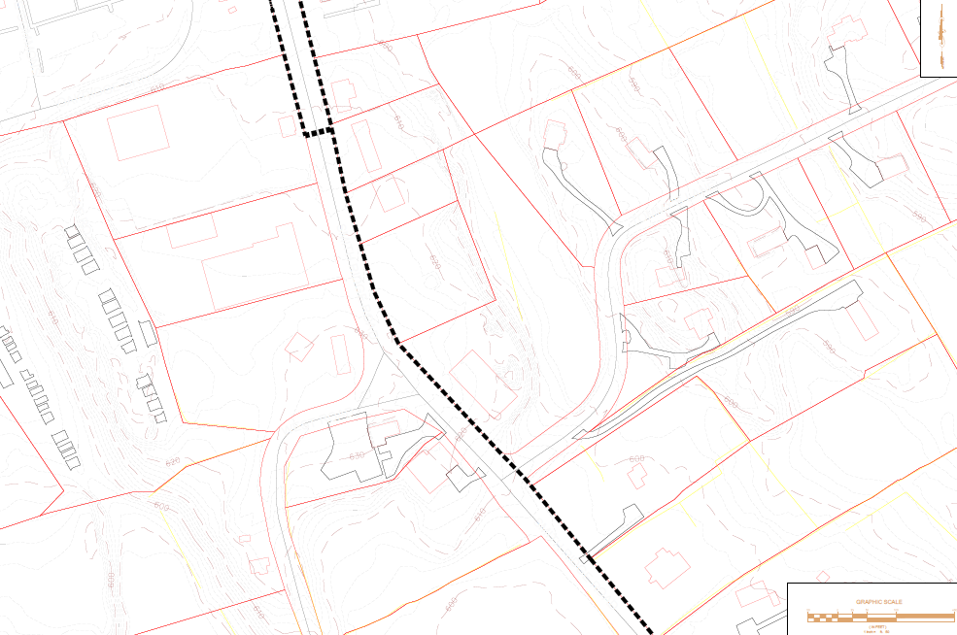
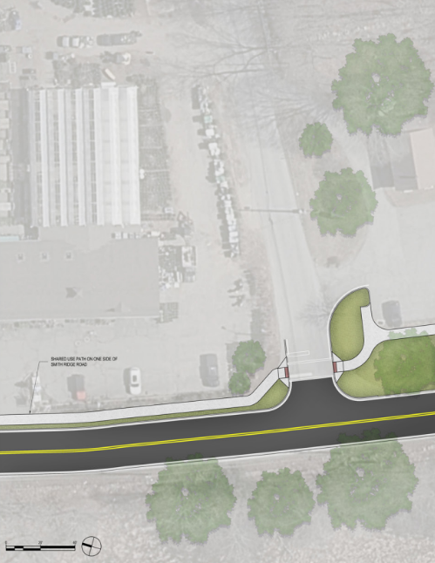
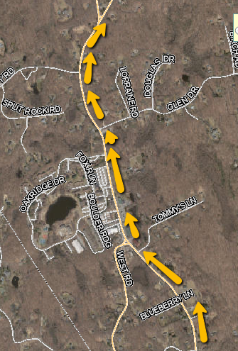
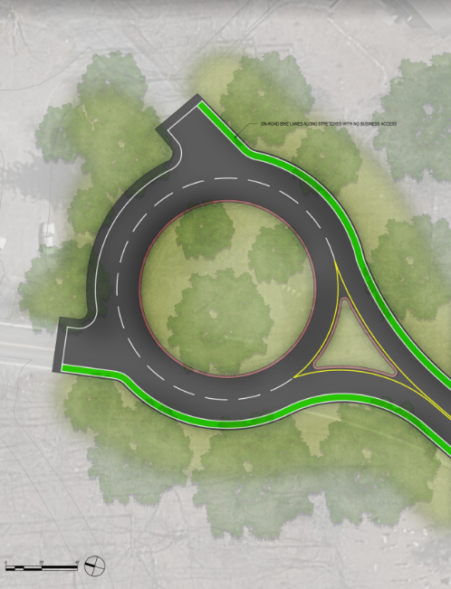
Identified projects/issues - Vista
Bike/pedestrian path along 123 - creating a Main Street
Vista Hamlet Stewardship Council initiated studies

Slide 11
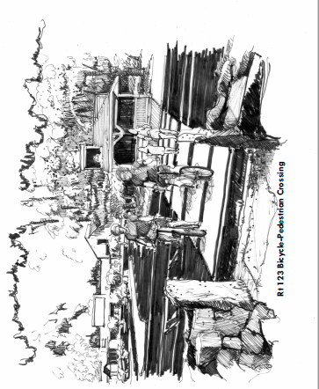
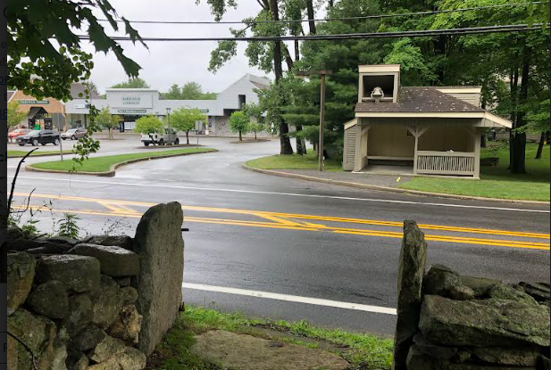
Identified projects/issues - Vista
Crosswalks - Oakridge, VFD

Slide 12
Possible bond fund usage
Construction
Design
Planning
Right-of-way acquisition
Permitting costs

