Slide 1
Lewisboro Library budget presentation
2/14/2022
9/18/23

Slide 2
The modern public library
There aren’t many truly public places left in America. Most of our shared spaces require money or a certain social status to access. Malls exist to sell people things. Museums discourage loiterers. Coffee shops expect patrons to purchase a drink or snack if they want to enjoy the premises.
One place, though, remains open to everybody. The public library requires nothing of its visitors: no purchases, no membership fees, no dress code. You can stay all day, and you don’t have to buy anything. You don’t need money or a library card to access a multitude of on-site resources that includes books, e-books and magazines, job-hunting assistance, computer stations, free Wi-Fi, and much more. And the library will never share or sell your personal data.
Source: “The Modern Public Library” by Jennifer Howard, Humanities Magazine.

Slide 3
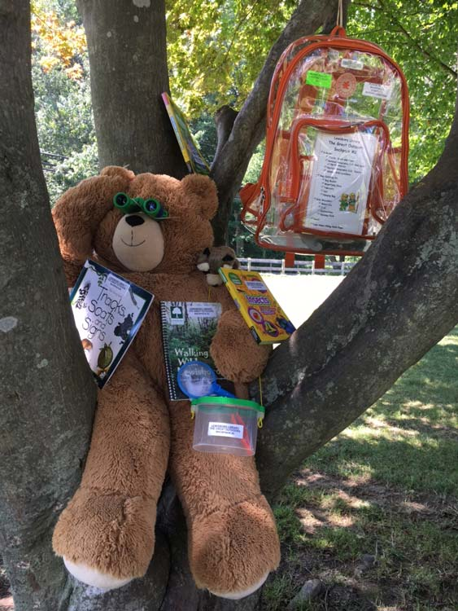
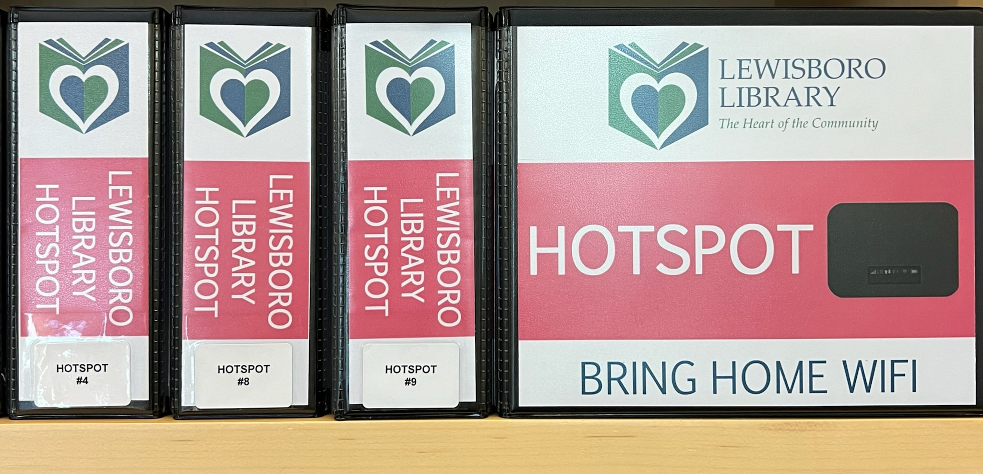
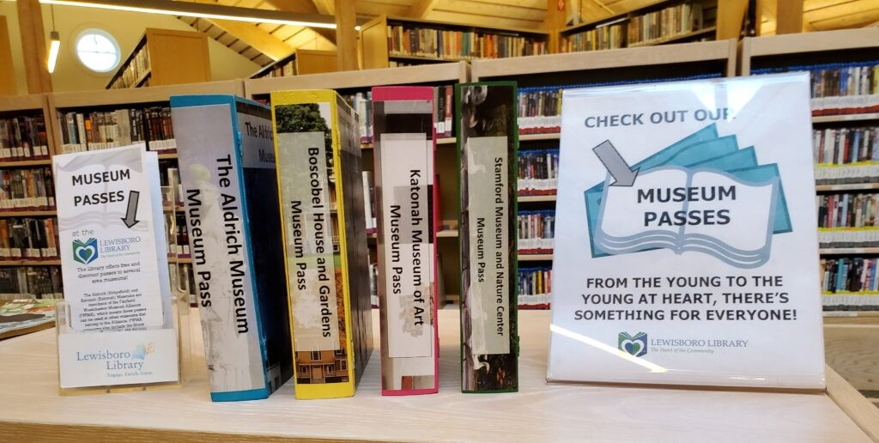
How are we doing? Highlights of 2023
Library of Things:
Wifi hotspot lending
Museum passes
Fishing rods & tackle boxes
Discovery backpacks for kids

Slide 4
Highlights of 2023
Program Attendance (In person & Virtual) (adults, teen & children)
2022 3,158 attendees
* As of September 2023 3,659 attended library programs – 15.9% increase over all of 2022.

Slide 5
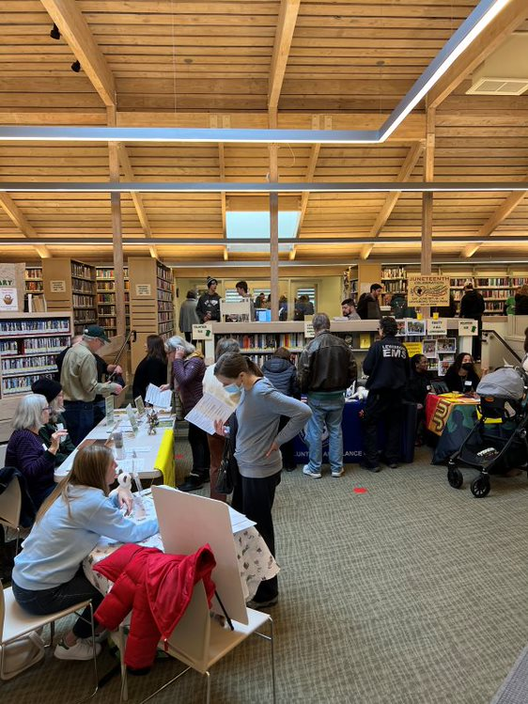
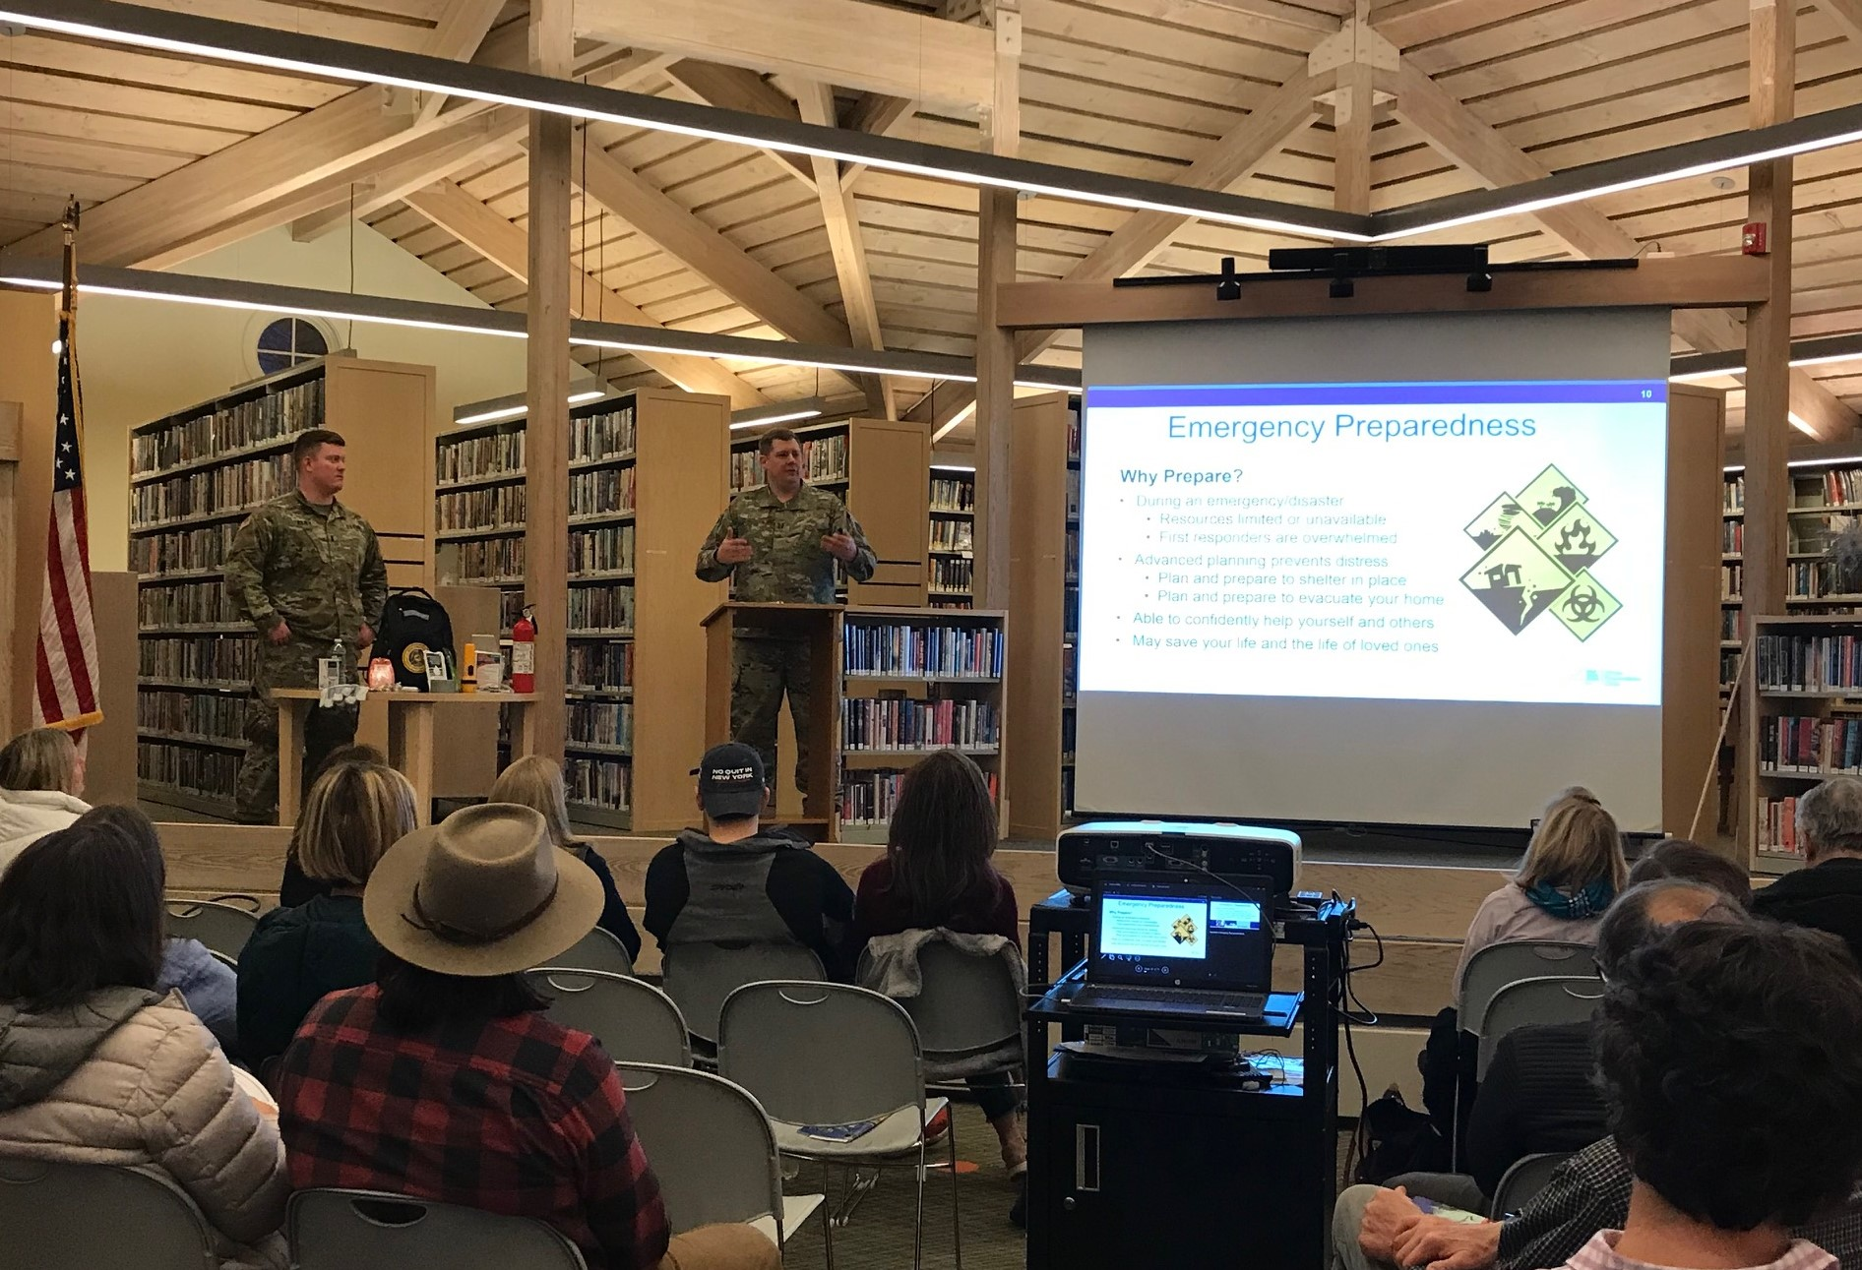
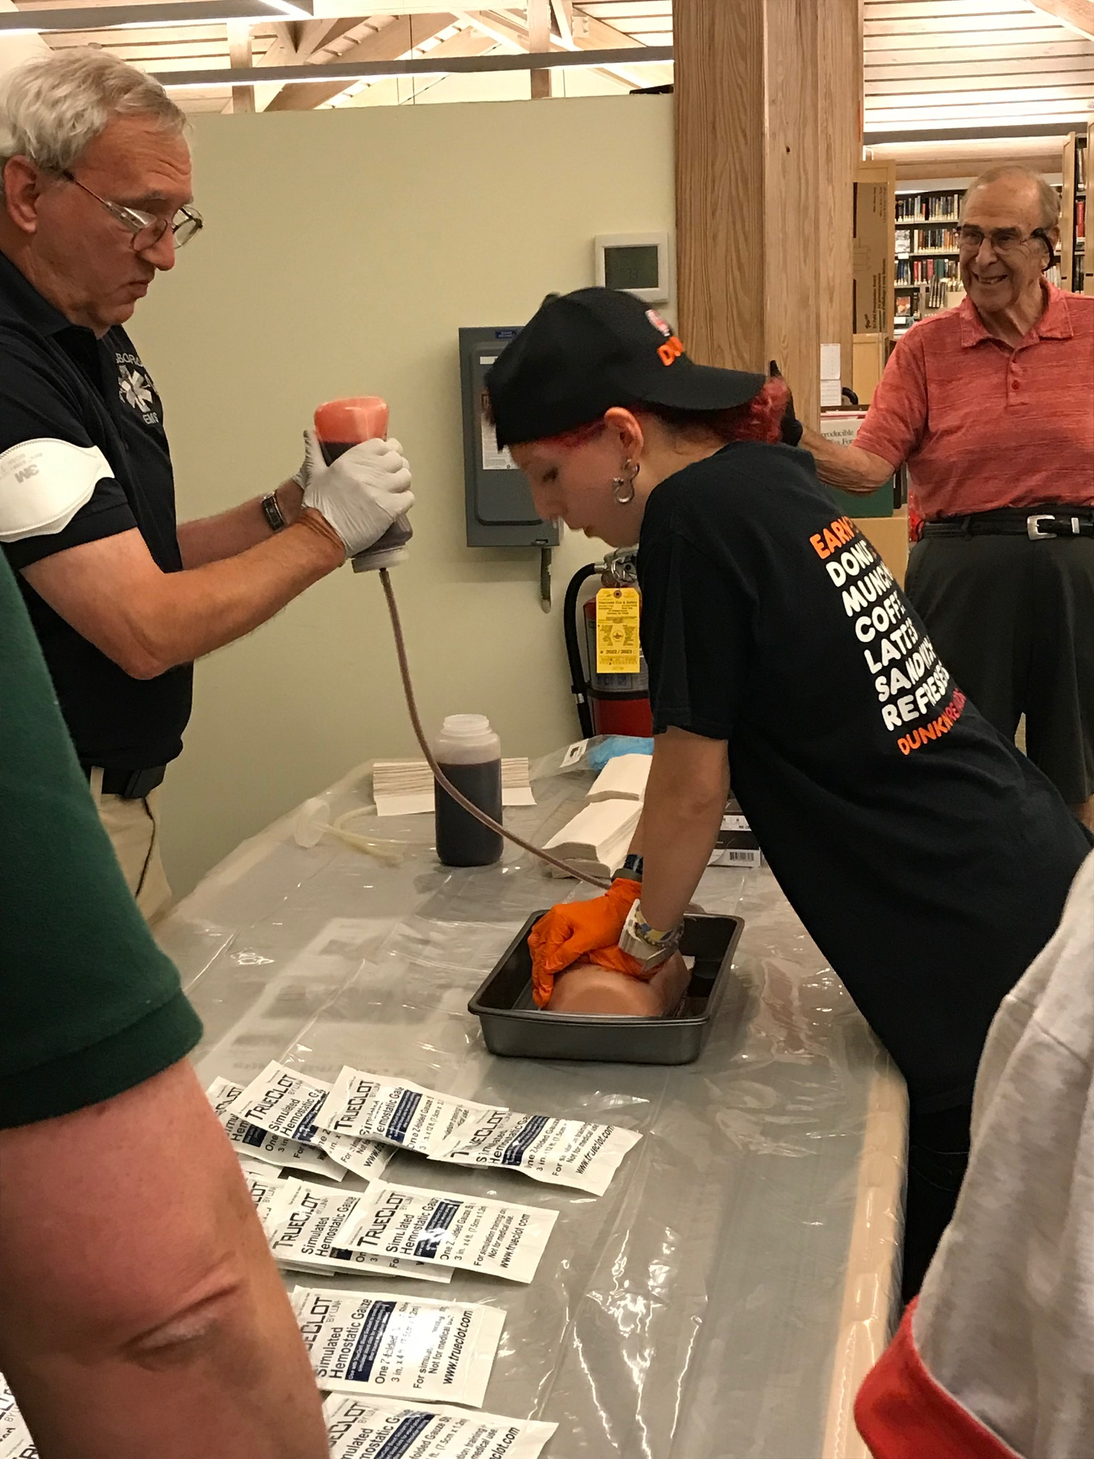
Adult programs
Emergency Preparedness with the Citizens
Preparedness Corps
Stop the Bleed with the Lewisboro Volunteer Ambulance Corps
Volunteer Fair

Slide 6
Adult programs
Community Crafters

Slide 7
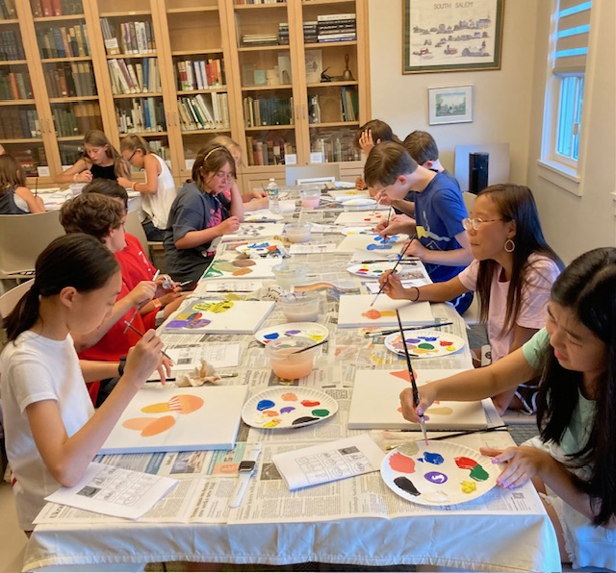
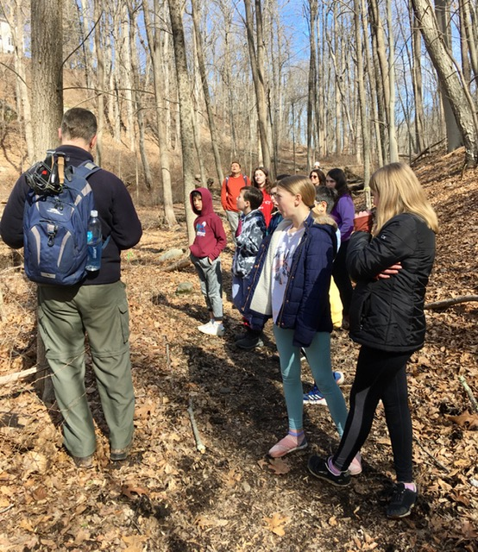
Teen programs
Paint Night
Teen Hike with Partner Lewisboro Land Trust

Slide 8
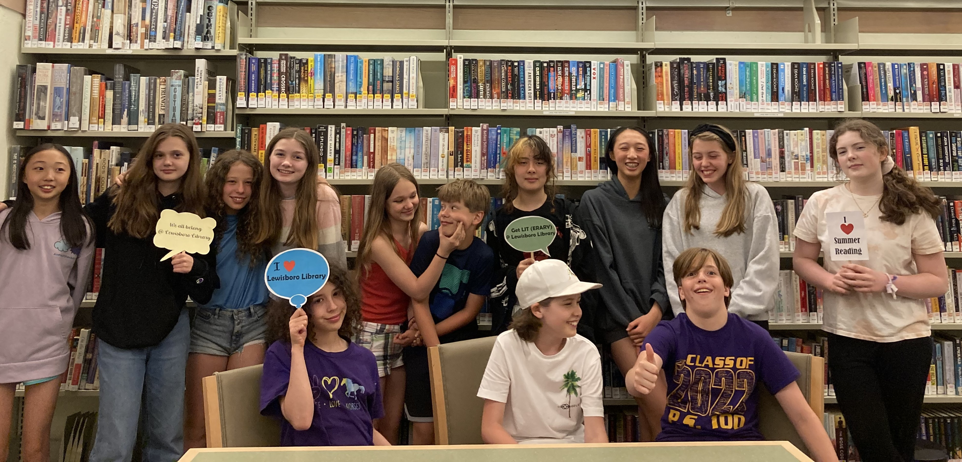
Teen programs
Teen Summer Reading Program Kickoff

Slide 9
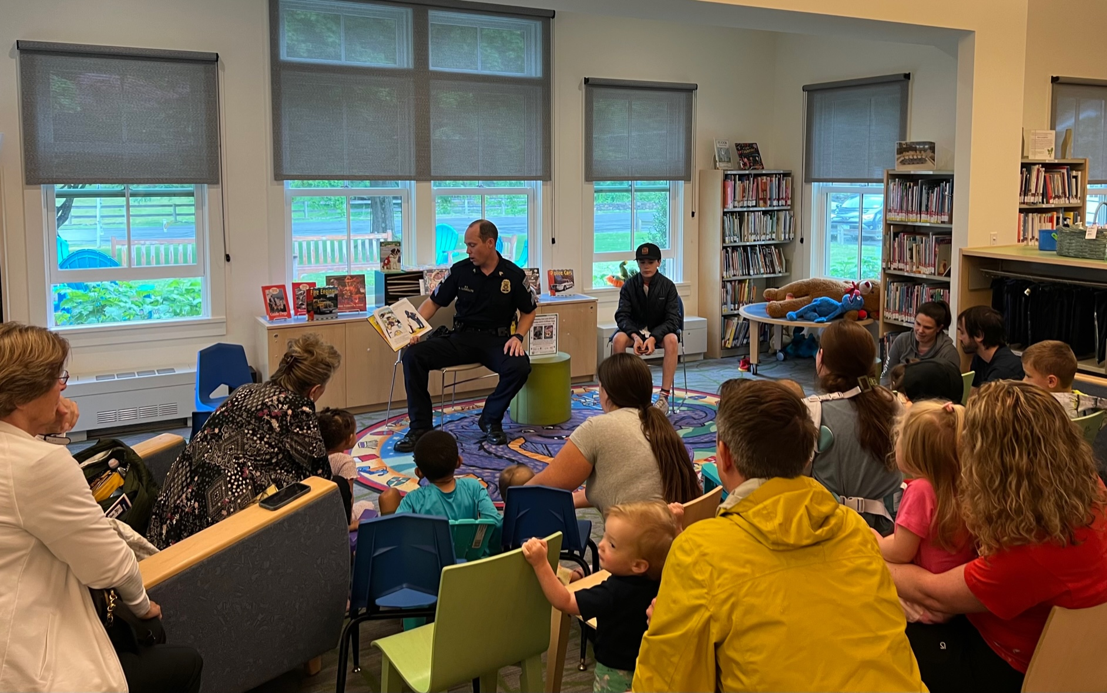
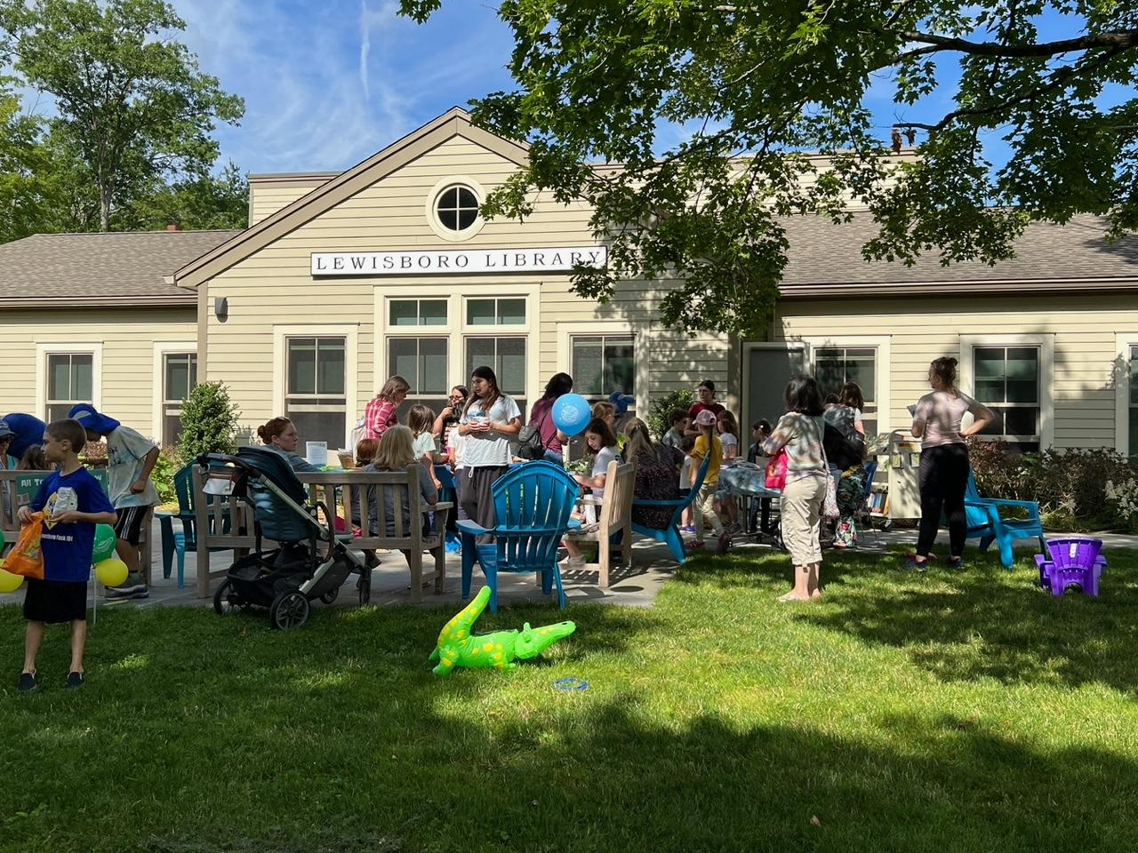
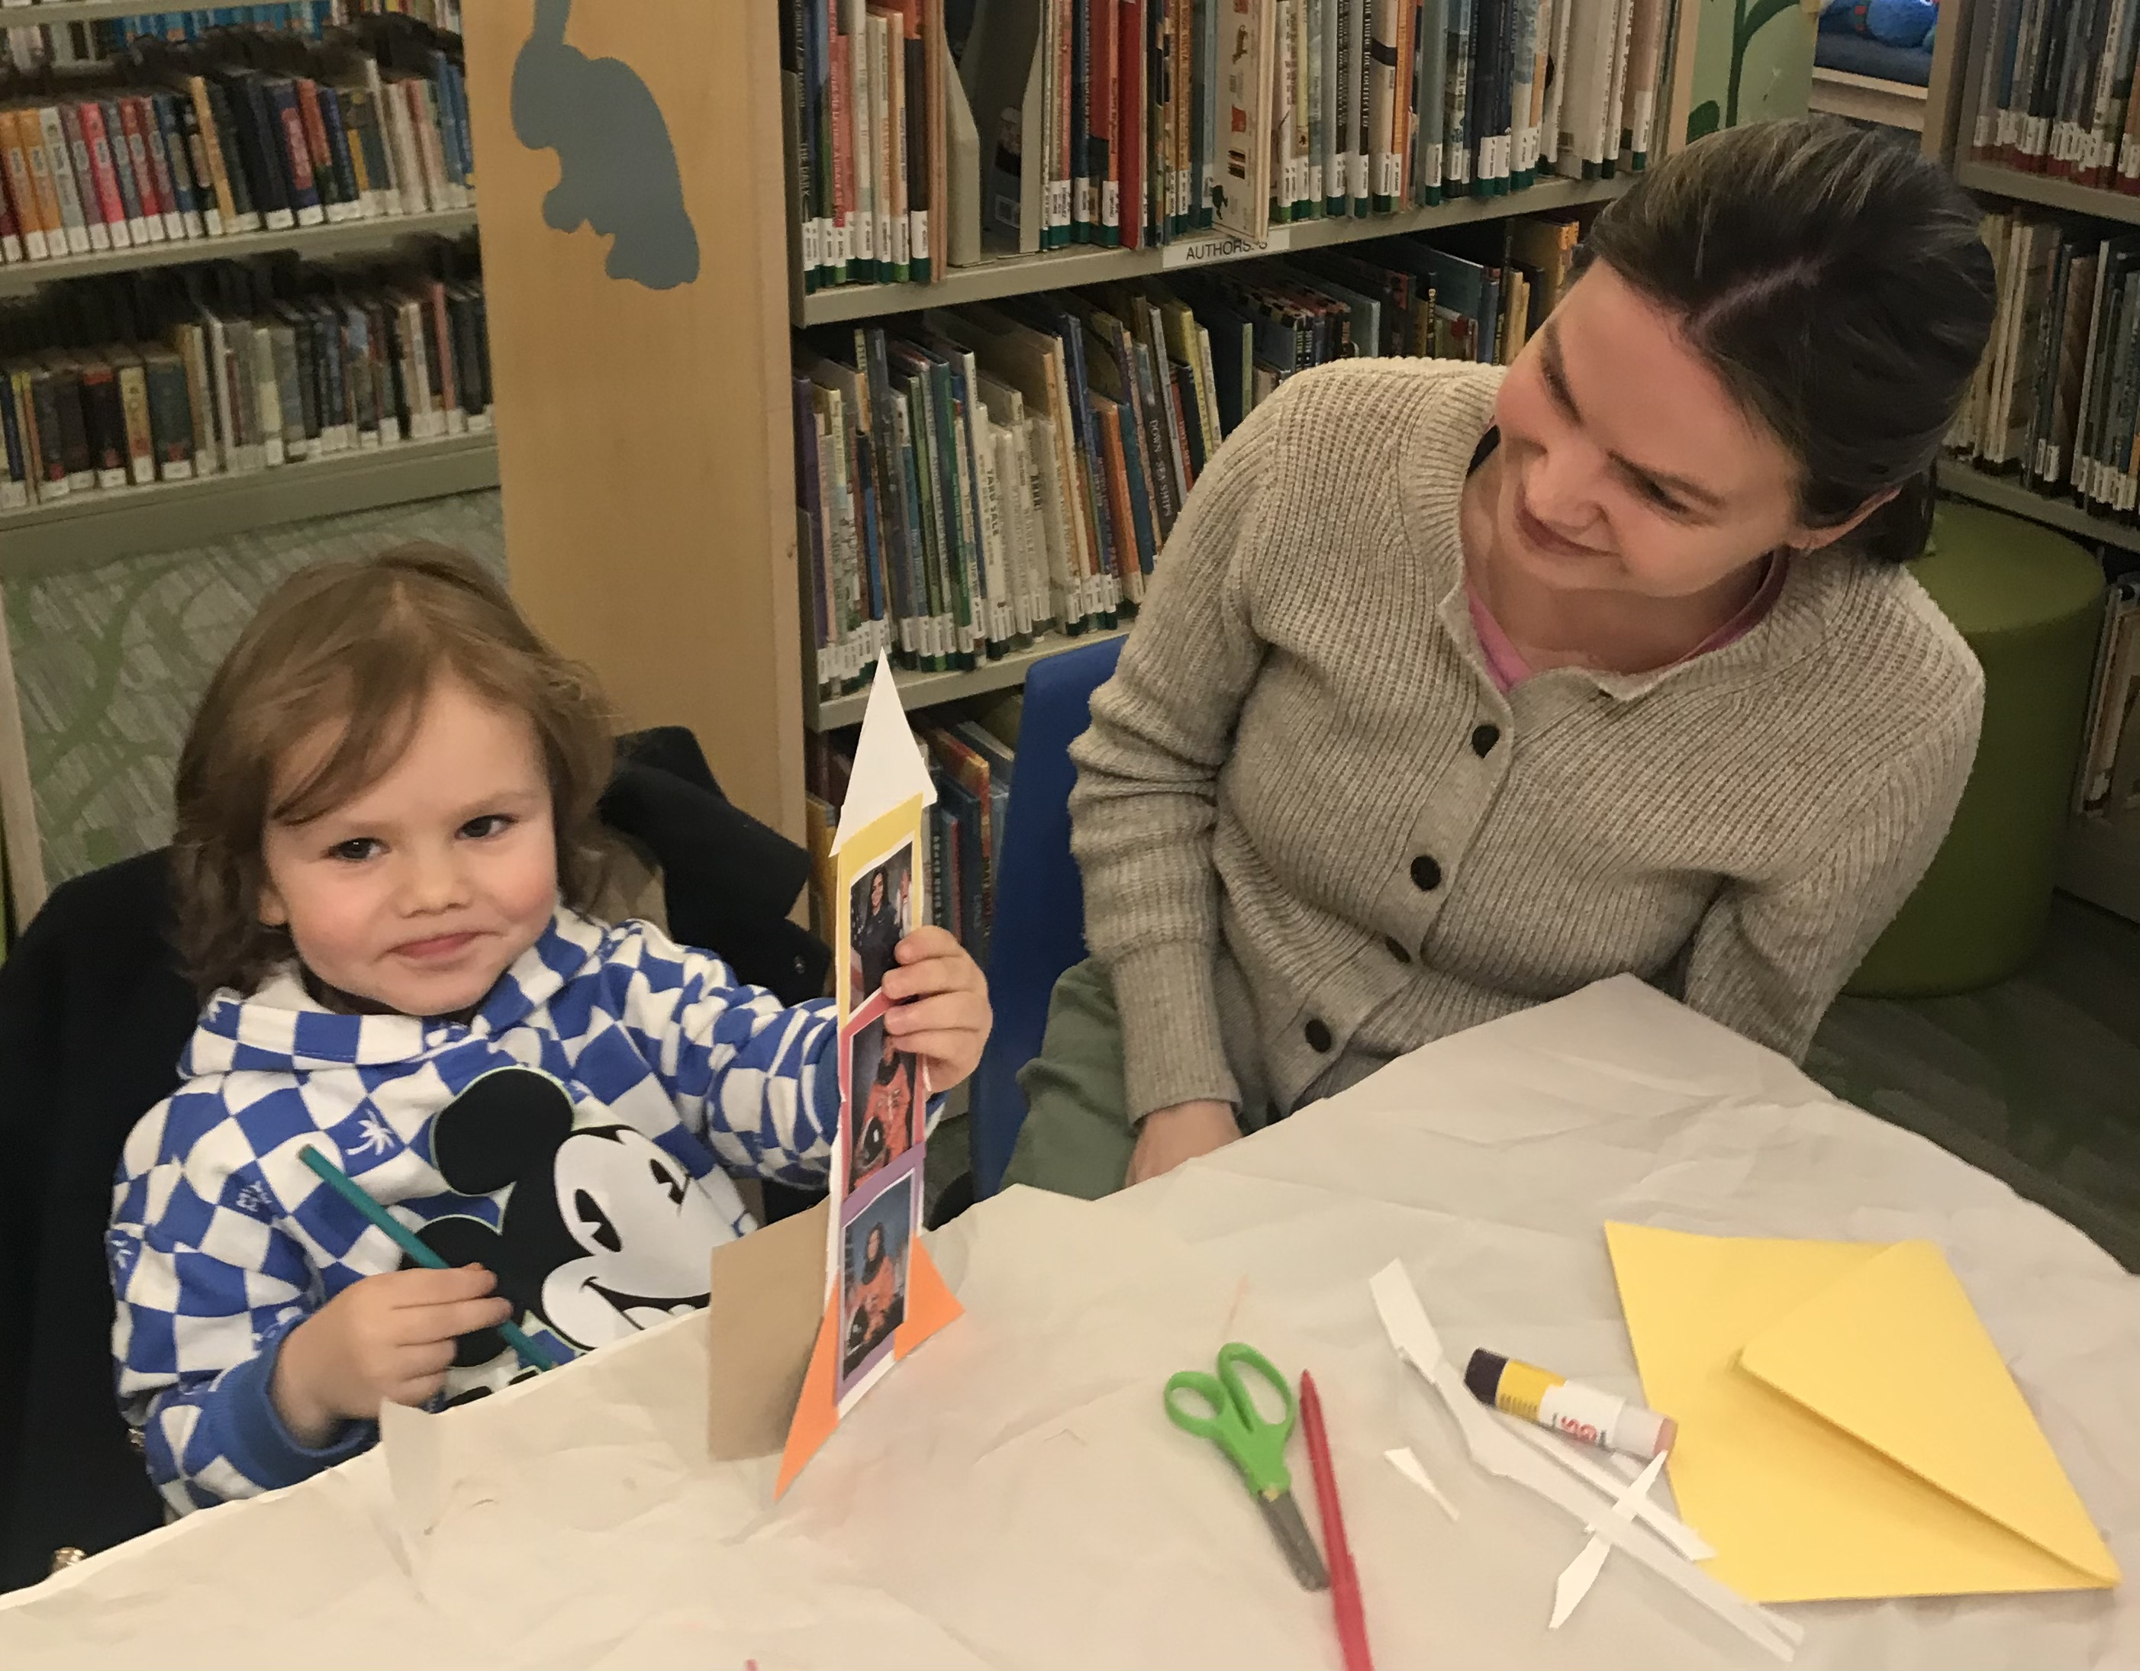
Children’s programs
Story Hour with Officer Llewellyn and Zane
Summer Reading Kickoff Party
Makerspace Wednesday Crafts

Slide 10
How are we doing?
Total Circulation of Library Print & Digital Materials:
2019 103,092 Pre-COVID
2020 77,881
2021 77,739
2022 92,022 18.37% increase
* As of August 2023, up 20% over August YTD 2022.
Current ratio of print vs digital borrowing is 60% print and 40% digital.
Library Visits
2019 63,971 Pre-COVID
2020 36,135
2021 46,615
2022 56,227 20.6% increase
* As of September 2023, up 26.4% over September YTD 2022.

Slide 11
Facts & figures
Library Cards:
As of 2022, we had 6,330 library card holders.
9.1% increase from 2021.

Slide 12
ways we serve our community
Functioning as a warming/cooling & charging station for the community during emergencies
Providing meeting space for community & nonprofit groups
Providing cultural events such as concerts and plays
Local history center including library archives dating to c. 1800
Providing study space for students of all ages from elementary to graduate; Extending library hours during high school exam periods
Providing meeting space for tutors & students
Providing quiet working space for residents with small businesses
Providing public WIFI, public computers & printers in the building. Wifi extends outside the building when we are open and closed.
Promoting technological literacy with workshops on Excel, Google Drive, Online privacy, etc.
Assisting less technologically literate patrons with using computers for job applications, government forms, etc.
Lending wifi hotspots for to patrons whose internet access is limited
Museum passes
Homebound delivery service
Proctoring exams for independent learners
Book clubs

Slide 13
Library partners in the community
The library partners with the following community partners in planning & providing programs & meeting space:
Lewisboro Land Trust
Lewisboro Garden Club
Lewisboro Volunteer Ambulance Corps
League of Women Voters
Girl Scout & Boy Scout Troops
Katonah Lewisboro schools & PTOs
Local nursery schools
Home schooling community
Town of Lewisboro: Parks & Rec Seniors program, town historian, sustainability committee & town board.

Slide 14
Lewisboro Library Funding from the Town of Lewisboro
The Lewisboro Library is an association library. It is a 501©3 nonprofit organization that is chartered by the NYS Education Department as a public library.
The Library annually negotiates and contracts with the Town to deliver library services.
The Town currently funds the library at $495,806 or 74.2% of the Library’s operating budget.
This is only 3.52% of the Town’s total budget appropriations of $14,058,500.
In 2021, this resulted in the Town funding the Library at $35.74 per capita. This was the lowest per capita rate for library funding in Westchester County ranking 38 out of 38 libraries. (See the following chart.)
The Library currently must raise the remaining 25.8% of our operating budget in order to maintain our current level of services to our community.

Slide 15
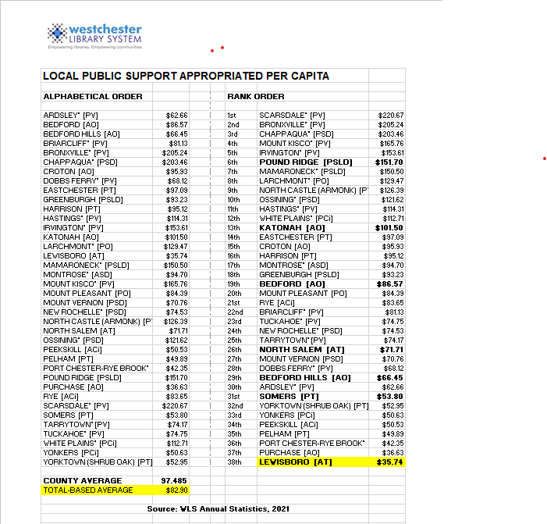

Slide 16
How do We raise the remaining funds?
Direct mail & social media annual appeals for donations
Library Fair
Library trustee directed fundraising events & sales
Library fees and fines
New York State Local Aid to Libraries

Slide 17
Library Budget notes
The finance committee recommends that the library board adopt a balanced budget this year. We have been adopting budgets with a net loss for the past few years and hope that we will make up the difference in fundraising. We have had to rely on our operating reserve to make up the difference in past years.
Failing this, the Library would have to decrease its operating hours, services, programs and purchasing of library materials for library collection.
Since 2009, the Library has had to dip into the operating reserve 8 times to cover an annual operating fund net loss.

Slide 18
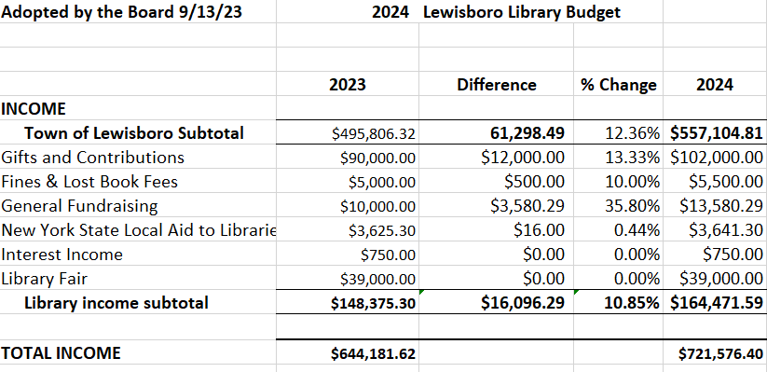

Slide 19
INCOME
Town of Lewisboro – We are requesting an increase of 12.50% or 61,975.79 more.
Library generated income:
- Increase Gifts & Contributions 13.33% from $90,000 to $102,000
- Fines & Lost Book Fees – increase by $500
- General Fundraising – increase by $3,580 to $13.5k based on fundraising committee events/raffles
- Library Fair – leave at $39,000

Slide 20
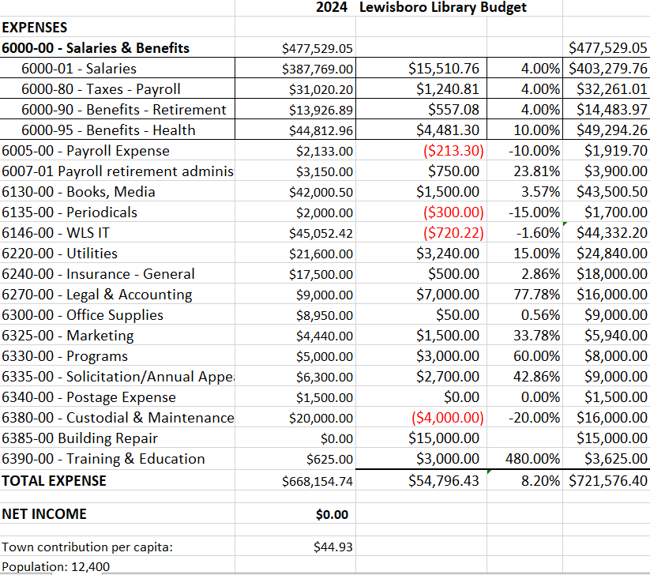

Slide 21
EXPENSES
Salaries – NYS is raising the minimum wage from $15.00 per hour to $16.00 in 2024.
Payroll – early quotes from other payroll companies indicate 10% savings.
Books, Media - increase by $1,500 to cover price increases and tremendous demand for digital content.
We’re close to meeting print demand but we would need an even bigger increase in this expense line to meet the digital demand of our patrons.
Periodicals
Cut periodicals by $300.
WLS IT
Their fee is increasing by 6% but we were able to reduce our fee by eliminating $720 by eliminating one underutilized staff computer and one public computer.
Utilities
Increase by 15% to account for increasing costs. We are already over our utilities budget this year.
Legal & Accounting: The Library has not had an audit for five years.
$13K to 15K for full audit this year for FY 2022.
$11k for FY 2023 review in 2024.
Add in $4,000 for legal

Slide 22
Office Supplies
Up .5% to make round number. This line is already higher because we folded the COVID and Equipment repair expense lines into this one.
Marketing
Increase by $1,500 to cover website redesign and maintenance.
Programs
Increase at minimum by the amount we spent on museum passes ($3,000)
Solicitation/Annual Appeal
Needs to be increased based on 2023 spending which included changes in annual appeal printing and mailing costs.
Custodial & Maintenance
Drop down to $16k and shift some funds to building repair.
Building Repair
Restored this expense line for 2024 due to increased repair needs since the building is no longer new. The Library is one of the busiest public buildings in town, besides the schools of course, with 56,000 people coming through our doors last year. It takes a toll on the building
AC condenser is going to be $5k. Suggesting $15,000 total for this expense.
Training & Education
Professional development for staff, national professional conference attendance restored since we stopped attending during the pandemic.
$3,000 ($2,500 for the conference, $150 for the other 3 full-time staff members)

Slide 23
Thank you!
The Lewisboro Library is very grateful to all our donors and volunteers that help the Library to serve our community!

