Slide 1
Town of Lewisboro Presentation
February 13, 2024

Slide 2
Agenda
Welcome and Introductions
NYSEG & System Overview
Electric Operations Update
Vegetation Management
Outage by Cause
Questions

Slide 3
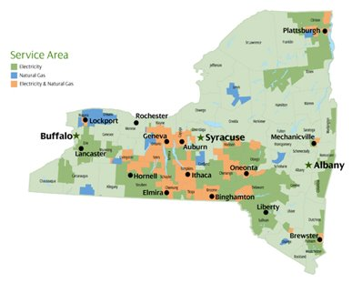
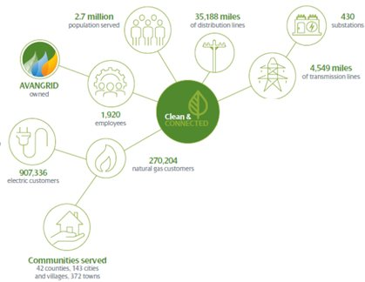
NYSEG Service Territory Overview

Slide 4
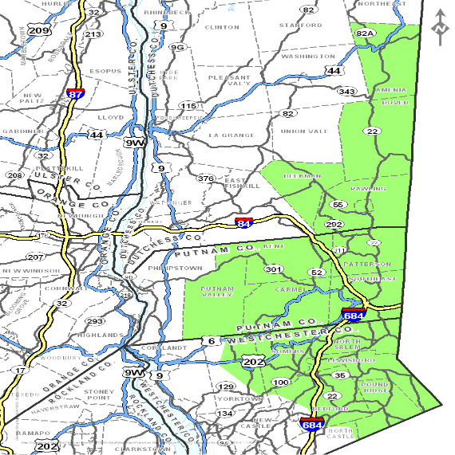
Brewster Division System Overview- Electric
The Brewster Division is 531 square miles and serves approximately 88,395 electric customers
The electrical system is comprised of:
32 substations
15 transmission lines
95 distribution circuits
2,399 circuit miles
1,630 overhead miles
769 underground miles

Slide 5
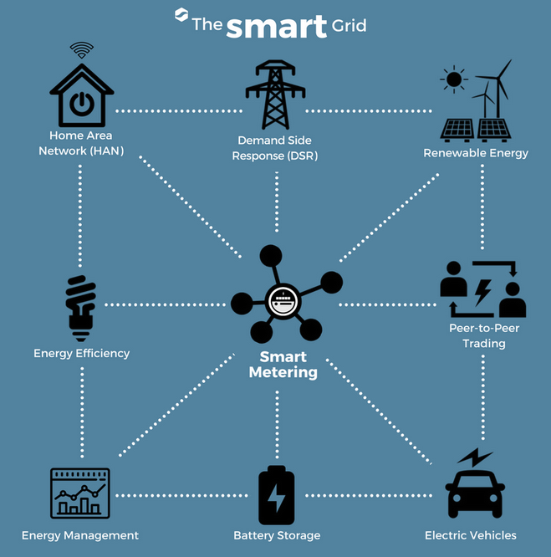
Customer Focus & Innovation- What is AMI?
AMI Customer Benefits
Account Management – No estimated billing, energy bills reflect actual usage
Energy Management – Data provides customers with usage information to better manage consumption and budgets. Supports energy efficiency efforts and New York State energy policy goals.
Outage Management – Automated communications to the utility to improve outage detection, response and power restoration.

Slide 6
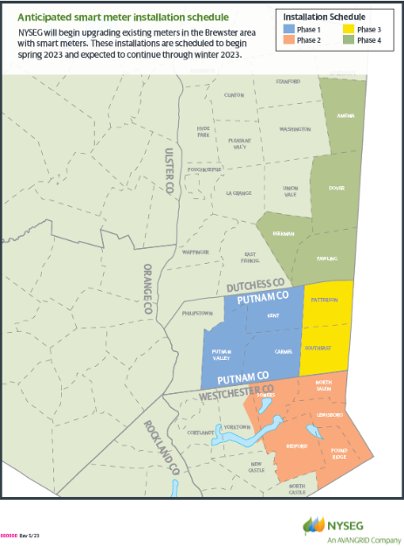
Brewster Installation Schedule
When: Installations in NYSEG's Brewster division began in May 2023 and are expected to continue through August 2024.
Total Installations: As of 02/9/24:
26,654 total installs
Where: Installations will occur throughout NYSEG’s Brewster Division. This includes portions of Dutchess, Putnam and Westchester counties.

Slide 7
Installation: What customers can expect
1
Mail notification
Customers receive a postcard in the weeks before installation.
2
Phone notification
Customers receive an automated phone 1-2 days before installation.
3
Installation field visit
A technician visits the customer to install smart meter.
4
Successful installation
A doorhanger is left to let the customer know the installation is complete.
5
That’s it!

Slide 8
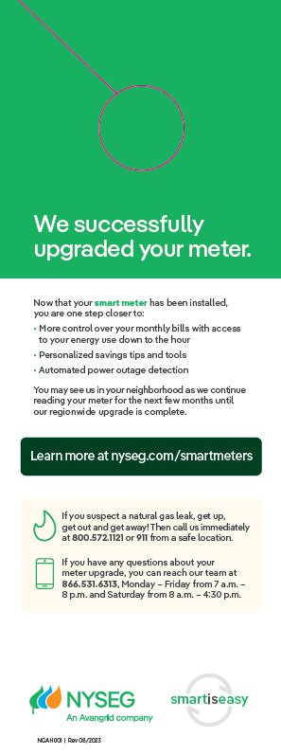
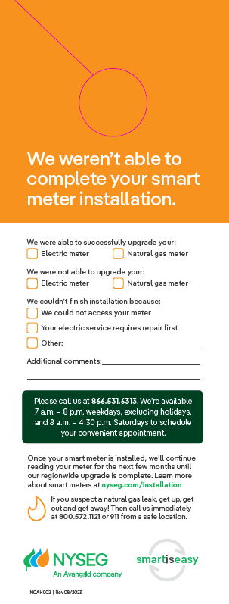
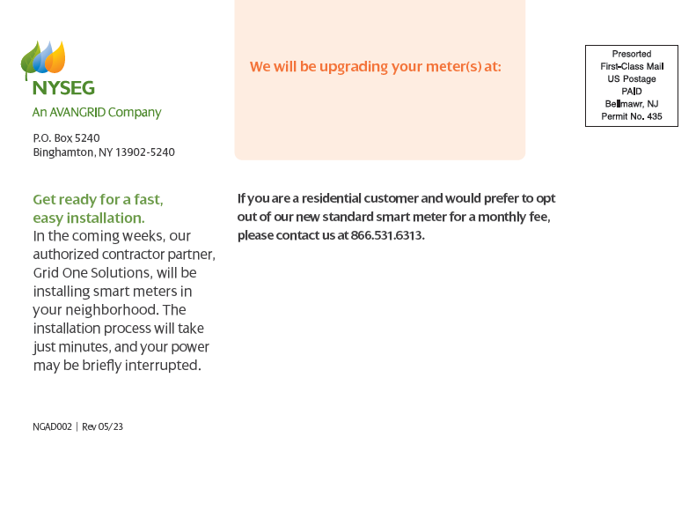
Customer Communications and Outreach
Postcard
Door hangers

Slide 9
Electric Operations

Slide 10
Completed Resiliency Projects: Overall Construction Summary
Circuit | Town | % Complete/ Completion Date | Work Overview
Golden Bridge 414 | Lewisboro, Bedford | 2021 | Replace 119 Poles 75 years old

Slide 11
Completed Automation Projects: Overall Construction Summary
Circuit | Town | Work Overview
Bedford Hills 227 | Bedford | 2 Regulators
Bedford Hills 462 | Bedford | 1 Capacitor
Cantitoe 497 | Bedford | 1 Tripsaver
Golden Bridge 417 | Bedford | 2 Reclosers
Golden Bridge 414 | Bedford, Lewisboro, N. Salem | 2 Reclosers, 1 Capacitor, 1 Tripsaver
Croton Falls 515 | N. Salem | 1 Recloser
Golden Bridge 421 | N. Salem | 2 Reclosers
Peach Lake 249 | N. Salem | 1 Regulator, 1 Recloser
Peach Lake 250 | N. Salem | 1 Regulator, 3 Reclosers

Slide 12
Completed Division Betterment Projects: Overall Construction Summary
Circuit | Town | Work Overview
Croton Falls 515/421 | North Salem | Installed X miles of new conductor Installed 1 new SCADA tie switch Replaced X poles and installed X new poles
Golden Bridge 421 | North Salem | Relocated 3 phase section of line from backlot to roadside Replaced 12 poles and added 5 new midspan poles to the roadside Installed ~7500’ of new 477 wire and ~2500’ of 4/0 neutral
Peach Lake 249, 250 Golden Bridge 414 | Bedford, Lewisboro, N. Salem | Created new tie between Peach Lake 249 and 250 circuits, upgrading 1 phase delta to 3 phase delta Created new tie between Peach Lake 250 and Goldens Bridge 414, upgrading all involved section to 3 phase Installed 2 new SCADA tie Switches Installed 3 phase step bank for Goldens Bridge 414 and Peach Lake 250 tie Installed ~4 miles of new 3 phase conductor Replaced X poles and installed X new poles
Wild Oaks URD | Lewisboro | Replaced old direct bury cable with jacketed cable in conduit Moved old back lot feed to roadside Created new 3 phase tie between Goldens Bridge 421 and 414 circuits, with 2 new switchgears installed Installed ~3800’ of 4/0 15 kV express cable for circuit tie and main feed Installed ~3700’ of #2 Al 15 kV of new cable Replaced 13 padmount transformers, removed 4 submersible transformers Replaced 9 aging poles on Nash Rd
814 Transmission Project- Cantitoe Tap |  | Replaced 55 structures on the double circuit section of the 814 line Installed 1 new midspan structure Changed framing from crossarm construction to davit arm construction for tangent structures

Slide 13
Completed Division Betterment Projects: Overall Construction Summary (continued)
Circuit | Town | Work Overview
Peach Lake 249-250 | North Salem | Created a tie point for the Peach Lake 249 & 250 circuits on June Rd Replaced 96 total poles Work performed on June Rd (Between Bloomer Rd and Titicus Rd) - Titicus Rd (Between June Rd and Route 121) Reconductored all Primary wire to 477 wire Performed extensive tree work to improve reliability All poles are built ready for any future conversion to 13.2kv All work is complete in field 2021-2022
Goldens Bridge 421 | North Salem | Route 22 relocation Relocated main three phase distribution line out of the woods and alongside Route 22 In order to improve reliability of a distribution line that was constantly affected during past storms. Replaced 19 total poles Work performed on Route 22 between 509 Route 22 & 463 Route 22 Reconductored all Primary wire to 477 wire Performed extensive tree work to improve reliability All work complete in field 2023
Goldens Bridge 421, Croton Falls 515 | North Salem | Extended NYSEG three phase distribution line (863) approx. 1 mile installing 24 poles along Route 22 in order to tie with the Croton Falls 515 circuit located near the intersection of Hardscrabble Rd Replaced 24 total poles Installed SCADA tie recloser to tie the two circuits (GB421 & CF515) SCADA tie recloser can help in storm restoration due to switching and sectionalizing capabilities Work performed on Route 22 between 555 Route 22 & intersection with Hardscrabble Rd Reconductored all Primary wire to 477 wire Performed extensive tree work to improve reliability All work complete in field 2020
Peach Lake 250, Golden Bridge 414 | Lewisboro & North Salem | Converted distribution lines from single phase to three phase, installed step transformer bank due to different voltages and created a new tie point to improve reliability Replaced 38 total poles Installed SCADA tie recloser to tie the two circuits (GB414 & PL250) SCADA tie recloser can help in storm restoration due to switching and sectionalizing capabilities Installed 3 step transformers due to different voltages of circuits(4.8KV PL & 13.2KV GB) Work performed on Route 121 between crossroads Bogtown Rd & Hawley Rd Reconductored all Primary wire to 477 wire Performed extensive tree work to improve reliability All work complete 2020

Slide 14
Completed Division Betterment Projects: Overall Construction Summary (continued)
Circuit | Town | Work Overview
Trip Savers (2021) | Bedford, North Salem | 1 installed in Bedford 5 installed in North Salem
Trip Savers (2022) | Pound Ridge, Lewisboro, Bedford | 4 installed in Pound Ridge 3 installed in Lewisboro 1 Installed in Bedford
Trip Savers (2023) | Pound Ridge, Lewisboro, Bedford | 1 installed in Pound Ridge 3 installed in Lewisboro 1 installed in Bedford

Slide 15
Pole Replacement
2020
Location Code | Total
Bedford | 7
Lewisboro | 13
North Salem | 16
Pound Ridge | 3
Total: 39
2021
Location Code | Total
Bedford | 4
Lewisboro | 5
North Salem | 1
Pound Ridge | 7
Total: 17
2022
Location Code | Total
Bedford | 16
Lewisboro | 6
North Salem | 4
Pound Ridge | 1
Total: 27
2023
Location Code | Total
Bedford | 8
Lewisboro | 9
North Salem | 8
Pound Ridge | 8
Total: 33

Slide 16
Planned Division Betterment Projects (2024)
Circuit | Town | Work Overview
Bedford Hills 225 | Bedford | Upgrading this circuit to increase reliability by completing the following: Reconductoring 1,877’ of overhead 3 phase primary wire Installing a new 3 phase capacitor for better service voltage Transferring load from a section to a lighter loaded section Job to be designed in Q1 of 2024 and construction completed by the end of 2024

Slide 17
Resiliency Projects: Overall Construction Summary
Circuit | Town | % Complete/ Completion Date | Work Overview
Pound Ridge 455 | Lewisboro, Pound Ridge | 100% / Jun 2022 | 9.6 miles of circuit upgrade to create 3 new ties. 12 new SCADA switches. 5 new Tripsavers. 1 new Recloser
Golden Bridge 414 | Lewisboro, Bedford | 2021 | Replace 119 Poles 75 years old

Slide 18
Automation Projects: Overall Construction Summary
Circuit | Town | Work Overview
Bedford Hills 227 | Bedford | 2 Regulators
Bedford Hills 462 | Bedford | 1 Capacitor
Cantitoe 497 | Bedford | 1 Tripsaver
Golden Bridge 417 | Bedford | 2 Reclosers
Golden Bridge 414 | Bedford, Lewisboro, N. Salem | 2 Reclosers, 1 Capacitor, 1 Tripsaver
Croton Falls 515 | N. Salem | 1 Recloser
Golden Bridge 421 | N. Salem | 2 Reclosers
Peach Lake 249 | N. Salem | 1 Regulator, 1 Recloser
Peach Lake 250 | N. Salem | 1 Regulator, 3 Reclosers
Pound Ridge 455 | Pound Ridge | 1 Tripsaver
Pound Ridge 457 | Pound Ridge | 2 Tripsavers
Pound Ridge 458 | Pound Ridge | 1 Recloser
Pound Ridge 456 | Pound Ridge, Lewisboro | 2 Tripsavers

Slide 19
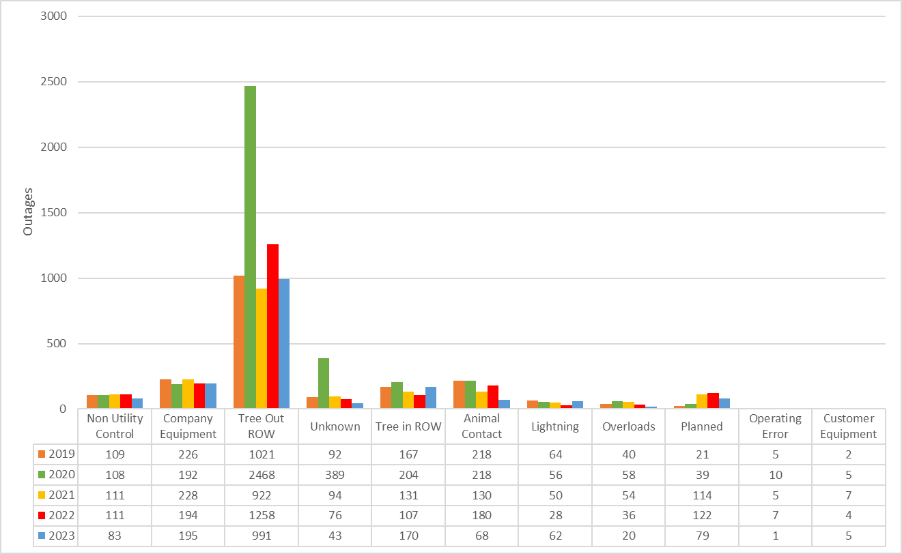
Brewster Division Outage by Cause

Slide 20
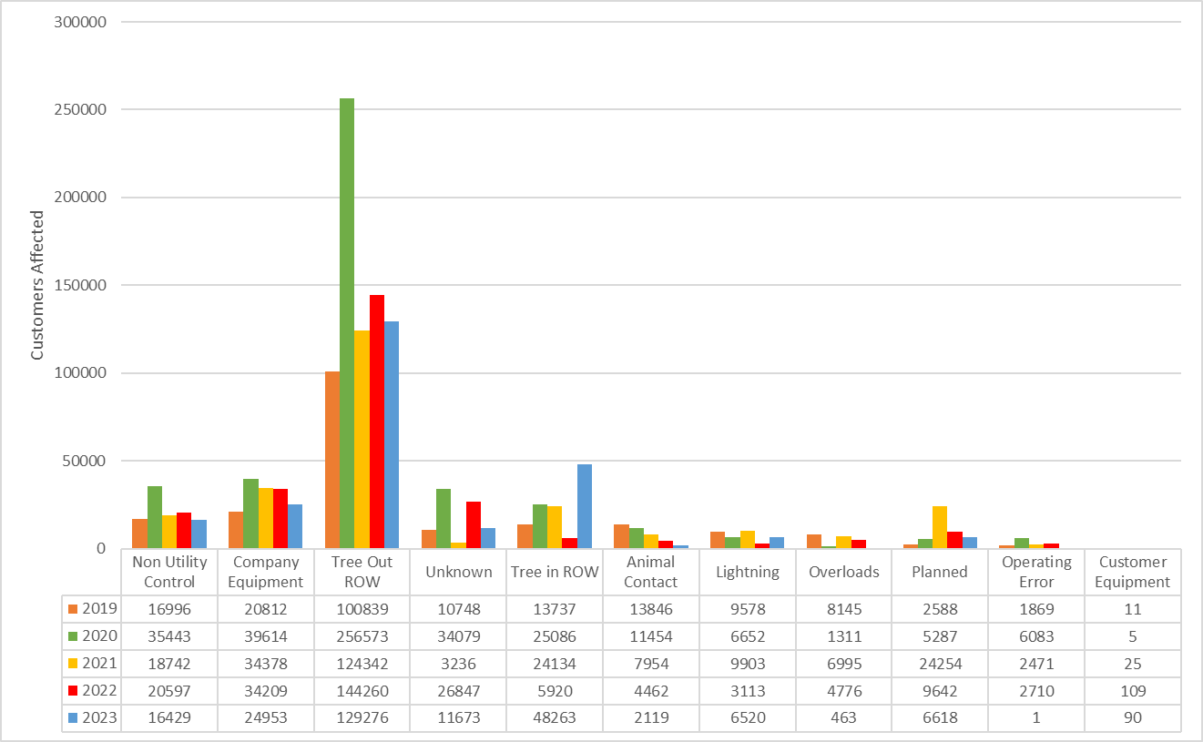
Customers Affected by Cause - Brewster

Slide 21
Lewisboro Reliability (Customer Count, Major Storm)
 | Company Equipment | Lightning | Non Utility Control | Overload | Planned | Tree in ROW | Tree Out ROW | Unknown
2019 | 2 | 0 | 0 | 0 | 11 | 0 | 4318 | 39
2020 | 1 | 42 | 5 | 3 | 52 | 1760 | 12514 | 607
2021 | 247 | 0 | 0 | 0 | 1117 | 838 | 1768 | 0
2022 | 0 | 0 | 0 | 0 | 949 | 209 | 15561 | 0
2023 | 0 | 171 | 0 | 0 | 1568 | 834 | 5592 | 2

Slide 22
Lewisboro Reliability (Customer Count, Minor Storm)
 | Animal Contact | Company Equipment | Lightning | Non Utility Control | Operating Error | Overload | Planned | Tree in ROW | Tree Out ROW | Unknown
2019 | 686 | 2363 | 2 | 664 | 0 | 4 | 1028 | 314 | 4553 | 2578
2020 | 2083 | 327 | 70 | 1278 | 0 | 1 | 0 | 2175 | 4375 | 154
2021 | 609 | 2285 | 2 | 1011 | 476 | 11 | 2679 | 32 | 2505 | 67
2022 | 611 | 205 | 35 | 2375 | 1 | 3 | 522 | 304 | 10888 | 442
2023 | 364 | 736 | 1 | 2642 | 0 | 2 | 32 | 1380 | 7889 | 12

Slide 23
Lewisboro Reliability (Customer Hours, Major Storm)
 | Company Equipment | Lightning | Non Utility Control | Overload | Planned | Tree in ROW | Tree Out ROW | Unknown
2019 | 45.334 | 0 | 0 | 0 | 12.47 | 0 | 31295.503 | 102.063
2020 | 30.517 | 100.686 | 6.75 | 37.551 | 78.452 | 22983.996 | 303290.906 | 40971.242
2021 | 316.901 | 0 | 0 | 0 | 409.939 | 2868.041 | 8303.76 | 0
2022 | 0 | 0 | 0 | 0 | 506.518 | 2226.352 | 86650.336 | 0
2023 | 0 | 1305.243 | 0 | 0 | 2844.107 | 8314.501 | 37884.813 | 4.8

Slide 24
Lewisboro Reliability (Customer Hours, Minor Storm)
 | Animal Contact | Company Equipment | Lightning | Non Utility Control | Operating Error | Overload | Planned | Tree in ROW | Tree Out ROW | Unknown
2019 | 967.608 | 2873.857 | 14.633 | 1640.663 | 0 | 7.799 | 120.276 | 525.84 | 7771.692 | 3817.528
2020 | 2475.194 | 659.701 | 203.739 | 1688.157 | 0 | 4.133 | 0 | 3031.617 | 8460.845 | 232.777
2021 | 691.372 | 4177.907 | 12.9 | 7524.81 | 150.892 | 35.483 | 523.433 | 119.705 | 5786.587 | 86.208
2022 | 966.983 | 458.909 | 100.961 | 5137.821 | 1.917 | 8.766 | 530.928 | 341.332 | 26623.07 | 890.562
2023 | 656.763 | 1988.529 | 3.25 | 1581.32 | 0 | 2.117 | 35.866 | 3034.386 | 14118.805 | 20.067

Slide 25
Energized for Good – Our way of giving back to our communities
We pride ourselves on volunteering and donating to local non-profit organizations
Our company volunteer hour's goal:
2023 – 14,000
2024 – 21,000
2025 – 35,000
For every hour, an employee volunteers with an organization we donate $15, to a max of $1,500

Slide 26
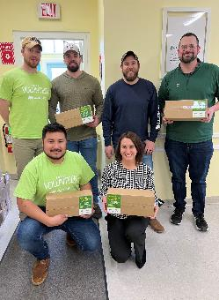
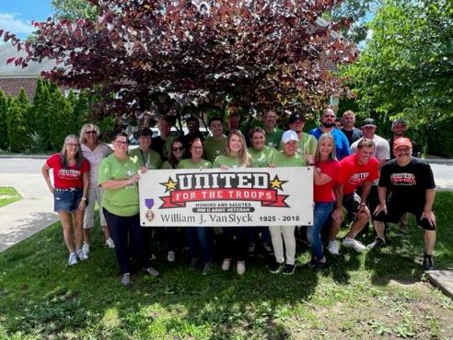
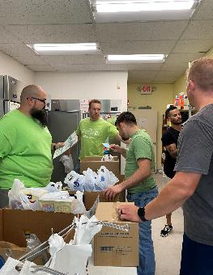
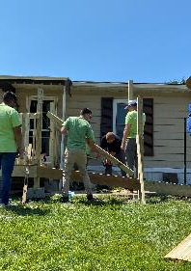
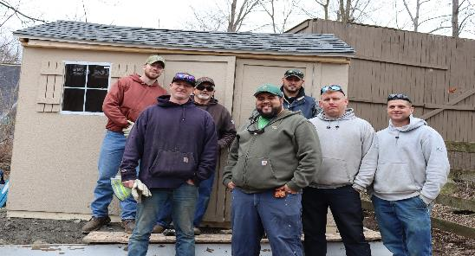
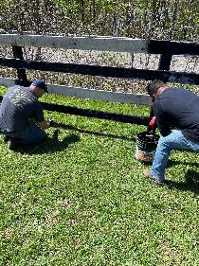
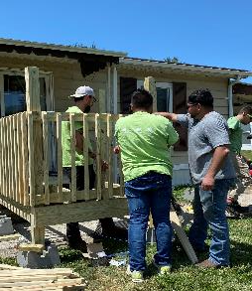
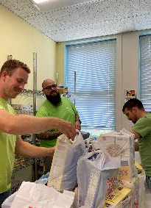
Brewster Division Volunteering!

Slide 27
Non-Profit Organizations We Give To

Slide 28
Questions ? Thank you!

